Slide 1


EBS Upgrades made easy
Approach for Automating and Streamlining Customizations
Archana Raghu PMP®
Doyen Systems Pvt Ltd
DEC-2019

Slide 2









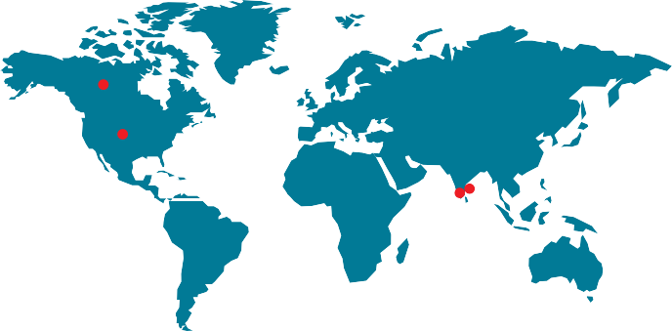

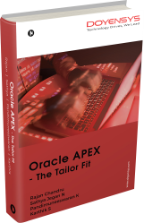



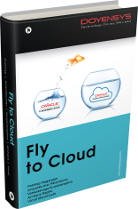
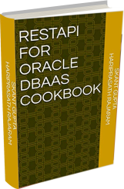

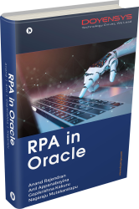


Oracle EBS
Servicing Customers for 13 Years
Service
offerings
Oracle
Fusion
Team strength
Certified Professionals
Packaged
Applications
250+
91%
Oracle APEX Development
Oracle Certified
MBA . PMI
Software
Services
Software
Development
30+ Delighted Customers
Oracle
Database
and
Middleware
Administration
Oracle Custom Development
US . India . Canada
Oracle
Cloud
Oracle
Technology
Books
Authored by
Doyens

Slide 3

Archana raghu
14+ Years of experience in Oracle technologies like EBS, Fusion Applications, OBIEE, APEX, ADF etc.
Certified Project Management Professional PMP® and Certified Procurement Cloud 2017 Implementation Specialist
Successful analysis and problem-solving expertise and proven project management experience.

Slide 4
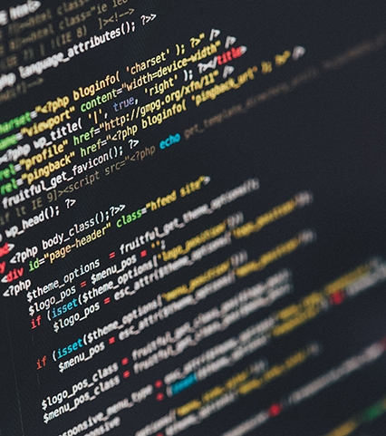
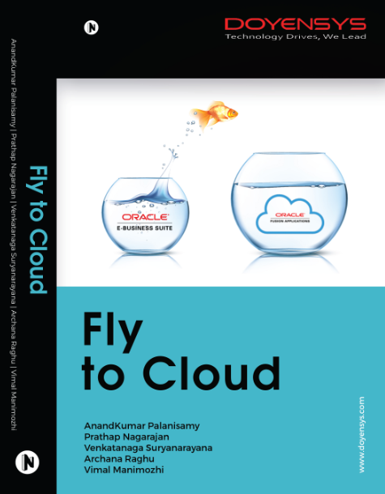
Available in Flipkart & Amazon
Notionpress & Doyensys websites

Slide 5
agenda
TOPICS TO BE COVERED
Introduction to Impact Analyzer
EBS Upgrades – What are the Challenges?
Customizations and their Impact – How to Identify?
Project Management – It is Made easy
How does Impact Analyzer Help You?
The End
Notes:
Add EBS View features – get from Rao

Slide 6
Impact analyzer
An Introduction

Slide 7


What is impact analyzer
An Introduction
Are you moving from 11i to 12i?
Are you moving from 12.1 to 12.2?
Are you moving from 12.2.x to 12.2.y?
Notes:
Add timelines for end of support for EBS versions of 11i, 12.1 etc

Slide 8
What is impact analyzer
An Introduction
Automating upgrades of EBS
Reduced timelines
Considerable savings in cost
Complete list of Customizations
Notes:
Automating upgrades from one EBS version to another
Reduced timelines
Considerable savings in terms of overall cost
Complete list of Customizations

Slide 9
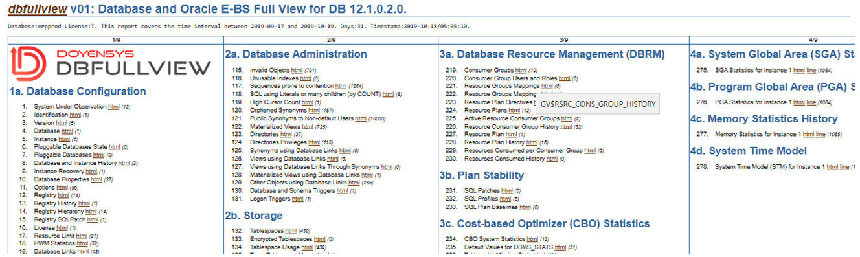
Db full view
DB Complete Picture

Slide 10

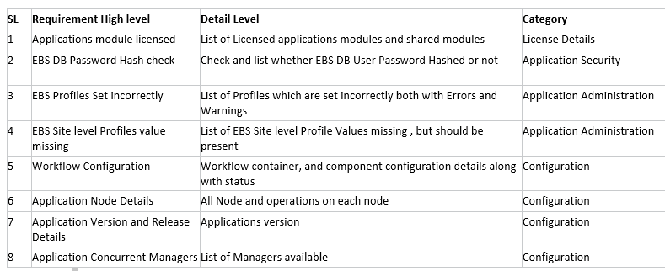
ebiz full view
Application Complete Picture

Slide 11
What is impact analyzer
An Introduction
Grouping/ Categorizing objects based on impact
Dashboards & Drill-down reporting
Estimations & Project Plans
Task Management & Project Management
Notes:
Grouping/ Categorizing objects based on impact
Dashboards & Drill-down reporting
Estimations & Project Plans
Task Management & Project Management

Slide 12

What is impact analyzer
An Introduction
Suggestions on the impact in the custom objects
Track the status of migration of the components
Task segregation based on complexity & status
Upgrade statistics generated within few hours
Available over cloud and can be tracked
Notes:
Suggestions on the impact in the custom objects
Track the status of migration of the components
Task segregation based on complexity & status
Upgrade statistics generated within few hours
Available over cloud and can be tracked

Slide 13
What is impact analyzer
An Introduction
Data security in Cloud
Metadata is easily readable format
Transparent output on achievable Vs not-achievable
Highlight dependencies in the objects
Notes:
Data security in Cloud
Metadata is easily readable format
Transparent output on achievable Vs not-achievable
Highlight dependencies in the objects

Slide 14
EBS Upgrades
What are the Challenges?

Slide 15
EBS Upgrades
What are the Challenges?
Identifying Customization
Integrations & Compatibility
Impact & Dependencies
Re-implementation Strategy
Awareness of new features in new version
Notes:
Identifying Customization
Integrations & Compatibility
Impact & Dependencies
Re-implementation Strategy
Awareness of new features in new version

Slide 16
Customizations & their impact
How to Identify?

Slide 17

CEMLI REPORT
Identify Custom Objects
CEMLI Report
Types of Objects
Compare with Metadata
Download to Excel
Customizations

Slide 18
Objects & impact
Identify Custom Objects
Intelligent system to identify impact
Distinguish Impacted and Non-Impacted objects
Graphical representation with drilldown

Slide 19
Impact Assessment
Identify Custom Objects
Classify objects based on IMPACT
Includes database objects and Application objects
Download to EXCEL

Slide 20
ADHOC OBJECTS
Identify Impact
Adhoc file processing
Impact assessment for single files
Database or application objects

Slide 21
Project Management
It is Made Easy

Slide 22
Estimation
Project Plan
Estimate objects with different levels of impact
Framework to break down activities involved
Automatic reports and dashboards based on impact
Arrive at effort in man days
Input to Project Management

Slide 23
ESTIMATION
PROJECT PLAN
Framework for defining estimates
Break-up of activities involved
Feed to project plan to arrive at schedule based on effort in man-days

Slide 24
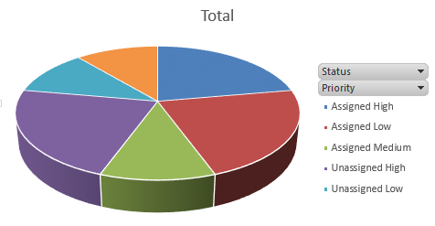
Task management
Task & User Management
Create users & tasks for activities involved
Assign tasks to users and monitor status
Project Management reports on tasks.
Manage through various phases of the project and different statuses till completion
Notes:
Check data and label

Slide 25
How does it make your life easy?

Slide 26
How does it help?
Task & User Management
Introduce New features
Finance modules specific functionality changes
Supply chain modules specific functionality changes
User Interface Changes
HTML pages replacing Forms

Slide 27
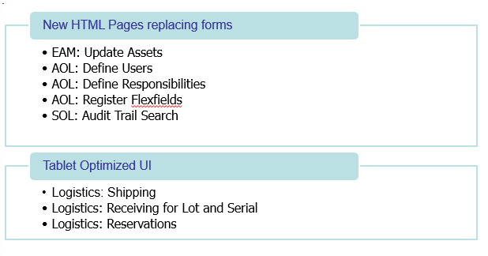
Example – Ui changes
SUBTITLE GOES HERE

Slide 28
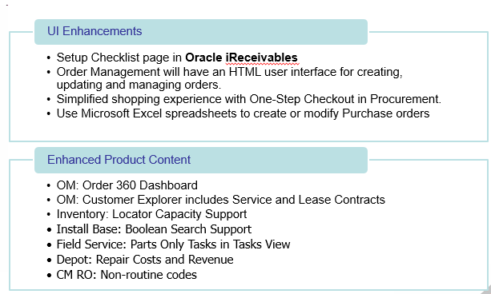
Example – ui changes
SUBTITLE GOES HERE

Slide 29
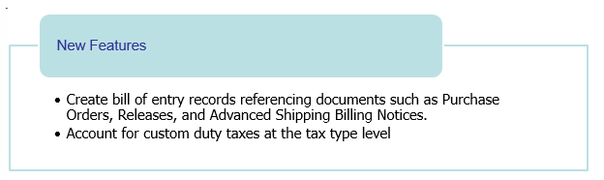
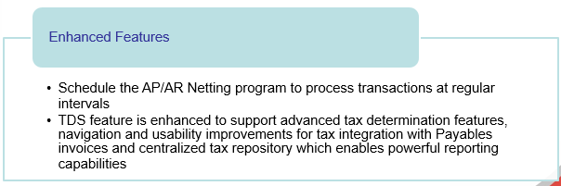
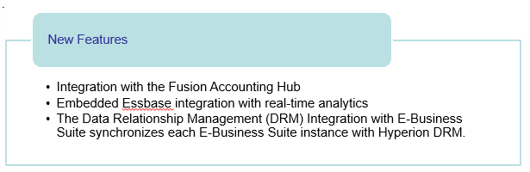
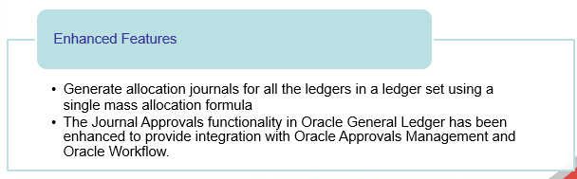

New features vs enhanced features
Financials – New Features
Financials – Enhanced Features

Slide 30
avoid redundant efforts automate monotonous activities smooth transition to new version
Streamline upgrade process

Slide 31

THE END

Slide 32


THANK YOU
WWW.DOYENSYS.COM
ARCHANA RAGHU
archana.raghu@doyensys.com

