Slide 1
Accelerate and Automate the Price Listing in EBS:
A Success Story
10999
Maintain Pricelist in Oracle E-Business Suite
Archana Raghu PMP®
Project Lead
Doyen Systems Pvt Ltd.
April-2019
Notes:
There are many challenges faced in Advanced Pricing in EBS. This session details a highly useful custom solution for maintaining pricelists in EBS. We will also look into the advantages of using this solution and how it helps in increasing the efficiency of the order to cash cycle.

Slide 2
Who We Are
A TECHNOLOGY SERVICE COMPANY THAT
PROVIDES INNOVATIVE SOLUTIONS AROUND THE ORACLE PLATFORM
With Laser focus on customer delight as the primary success parameter
Located at
Established
2006
Team strength
250+
US . India . Canada
Notes:
Our company was founded in 2006 in both US and India. We have 200+ employees and work primarily on Oracle technologies. We provide Oracle based solutions to our customers using a process driven global delivery model.

Slide 3
What We Do
SERVICE OFFERINGS
Oracle EBS
Packaged Applications
Oracle Fusion
Oracle Database and Middleware administration
Software Services
Software Development
Oracle APEX Development
Lift and Shift
Oracle Custom Development
Notes:
Our company was founded in 2006 in both US and India. We have 200+ employees and work primarily on Oracle technologies. We provide Oracle based solutions to our customers using a process driven global delivery model.

Slide 4
Presenter Info
Archana Raghu
Project Lead, Doyen Systems Pvt Ltd
13+ Years of experience in Oracle technologies like EBS, Fusion Applications, OBIEE, APEX, ADF etc.
Certified Project Management Professional PMP® and Certified Procurement Cloud 2017 Implementation Specialist
Worked on several projects focusing on conceptualizing business needs and translating them into viable technical solutions.
Successful analysis and problem-solving expertise and proven project management experience.

Slide 5
Agenda
Challenges in maintaining Pricelist
Salient Features
Approval Process
Supplementary Features
Reports
Demo
Notes:
Let us start with the challenges in EBS pricelist. Then we will move to the salient features of the solution being provided. A custom workflow is also built around this solution where the approval process is seamlessly handled. Then there are some additional features that help in understanding more details. We will then take a look at the important reports that are available to run at any time and then go through a demo before closing.

Slide 6
Challenges in maintaining Pricelist
Notes:
Am sure all of us have used OE Pricelists. So what are the challenges in using pricelist and attaching it to the sales order?

Slide 7
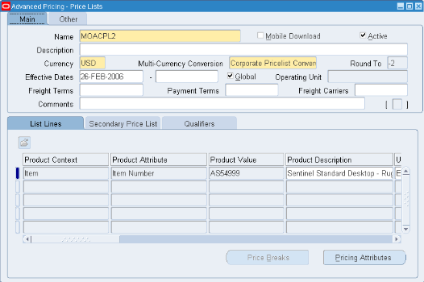
Pricelist in EBS

Slide 8
Challenges in Pricelist
Creating & Maintaining different prices for the same item
Maintaining price changes for different customers
Maintaining price revisions for every period
History unavailable for tracking purposes
Synchronization of data
Notes:
Same item – different prices for different customers
Wrong update of prices
Wrong pricelist attached to sales order

Slide 9
Challenges in Pricelist
Handling multiple overheads for different scenarios
Dynamically arriving at the item cost
Workflow not available for pricelist approval
Wrong pricelist being attached to the sales order
Order to Cash cycle affected – time consuming correction

Slide 10
Salient Features

Slide 11
Salient Features
Map Customers & Sales Managers
Framework to define quotes that are converted to pricelists
Customizable workflow process for approving quotes
Seamless integration to EBS & Synchronization of data
Accommodating custom requirements while maintaining pricelists
Notes:
Now that we have discussed the challenges in details, let us move on to the solution being offered.
What are the highlights or the important features that help in maintaining pricelists?

Slide 12
Salient Features
Options to maintain price revisions for different periods
Bulk upload of data for approval
Copy option for using existing data for next period
Integrated with EBS – pricelist & sales orders
Useful Reports to provide critical information
Email notifications at all stages of workflow
Notes:
Oracle SSO login used. Custom login can also be supported

Slide 13
Approval Process

Slide 14
Approval Process
Create a new Quote or view an existing Quote.
Create Quote Button - Quotes entered and saved.
Accruals defined from Oracle Trade Management.
Bulk upload - Import from Excel option.
Validations performed depending on the values entered.
Quote Lines entered and saved.
Notes:
The sales manager/marketing manager can create a new Quote or view an already existing Quote.
On clicking the Create Quote Button, it opens up the screen where Quotes can be entered and saved.
Accruals are defined from the Oracle Trade Management.
On clicking Import from Excel,screen to upload the excel pops up.
Quote Lines are entered and saved.
Accruals from Trade Management – claim and deduction management, budget management

Slide 15
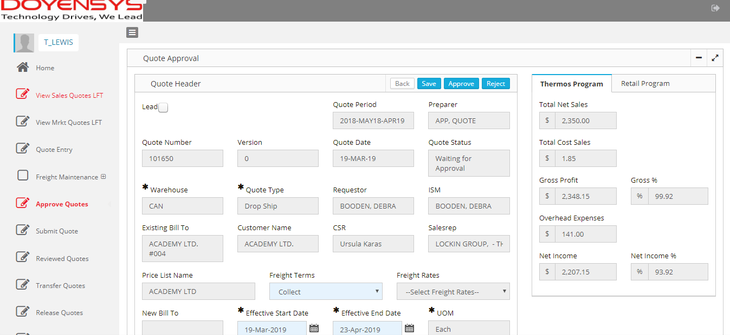
Approval Process
Enter/ Modify data - Click on Final Submit.
Quote submitted for approval.
Refresh Button to allow to re-pricing of Quote Lines
Accrual,Freight,Commission and Royalty recalculated.
Delete Button to delete quote when status is 'INCOMPLETE'
Delete Quote Lines if the lines are not approved.
Notes:
Validations are performed depending on the values entered.
Once all Quote lines are entered and modifications done to the quote,click Final Submit.
On clicking Final Submit,the quote is submitted for approval.
Refresh Button will allow to reprice the Quote Lines-Accrual,Freight,Commission and Royalty will be recalculated.All columns based on the above columns will be recalculated.
Delete Button deletes the quote when the status is in 'INCOMPLETE'
Quote Lines can be deleted if the lines are not approved.

Slide 16
Approval Process
Approval chain can be generated using multiple ways
Supervisory hierarchy
Any custom logic/ validation
Sales Manager
Submit
Sales Director
Approve
CFO

Slide 17
Approval Notifications
Email notifications sent at every stage of the workflow process
Requester submit the quote → notification sent to first approver
Notifications contain → quote number, customer, requester and URL
Click on URL to take action
Redirected to approval page of the application
Approver can approve, reject or modify the quote

Slide 18
Supplementary Features

Slide 19
Load Data from Files
Import data from excel files
Load new data
Update existing data
Lines not uploaded – displayed with error details

Slide 20
Save/ Delete Functionality
Save → Final Submit
Delete Button - Delete the complete quote
Only quotes with Incomplete Status

Slide 21
Copy Quote
Customer & Quote Number → Copy Quote
Copy existing quote to create new quote for next period
Quote created with Incomplete Status
Error handling if same data exists

Slide 22
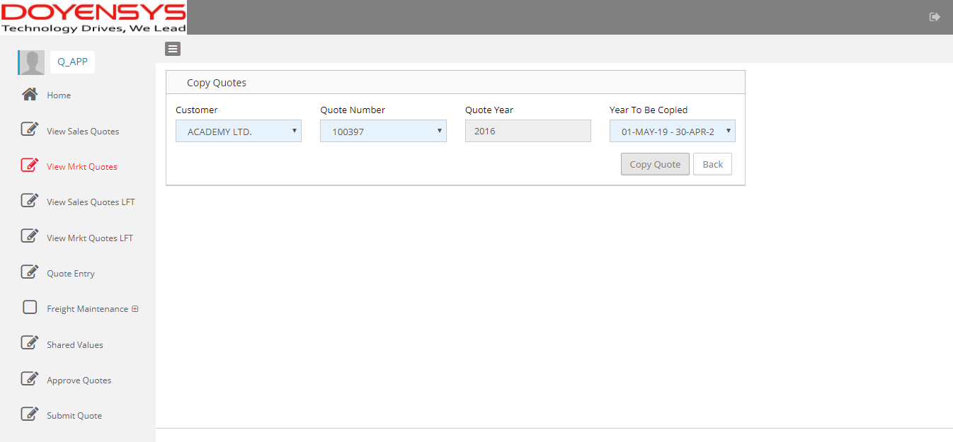
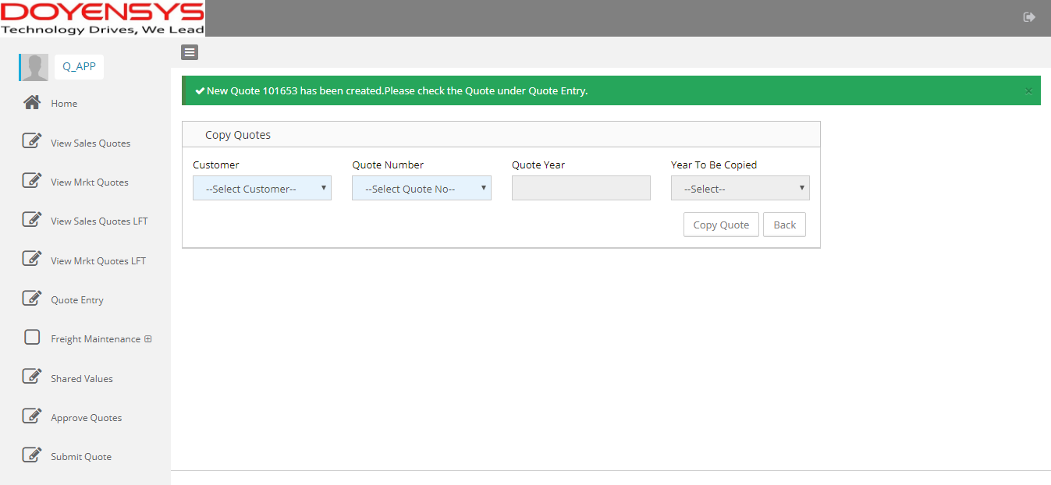
Copy Quote

Slide 23
Reports

Slide 24
Reports
Pricelist Details Report
Approval History Report
Interface Error Report
View Sales Quote Report
Accrual Report

Slide 25
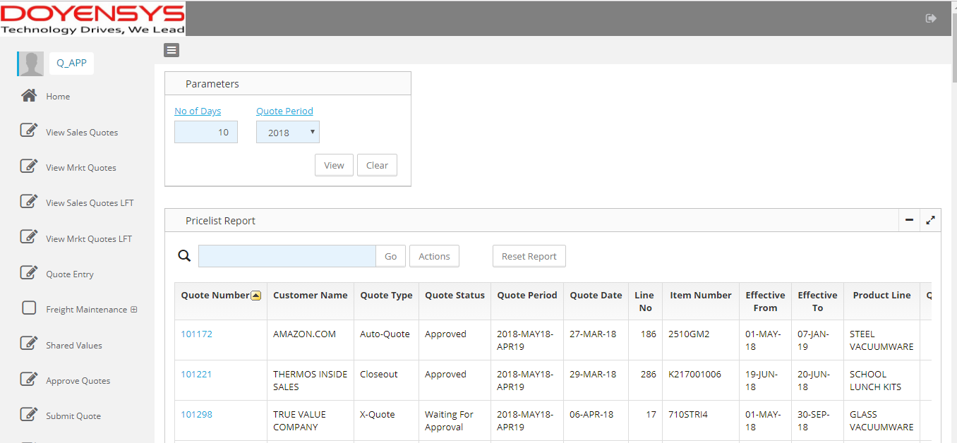
Pricelist Details Report
Details of pricelists created for a particular period

Slide 26
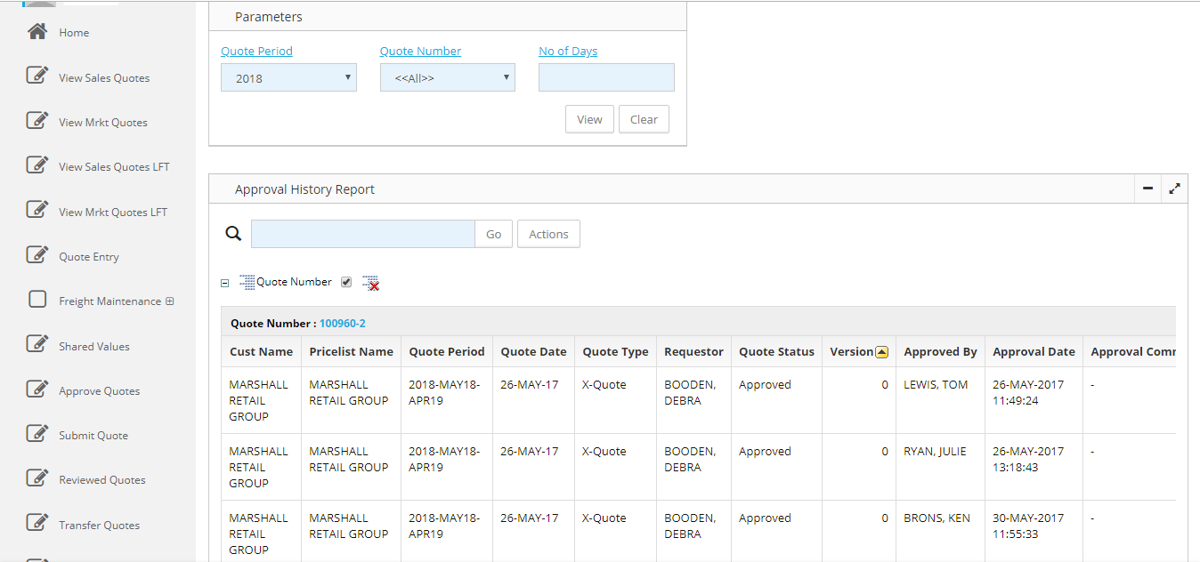
Approval History Report
History of approvals for every pricelist
Based on quote period and optionally on quote number

Slide 27
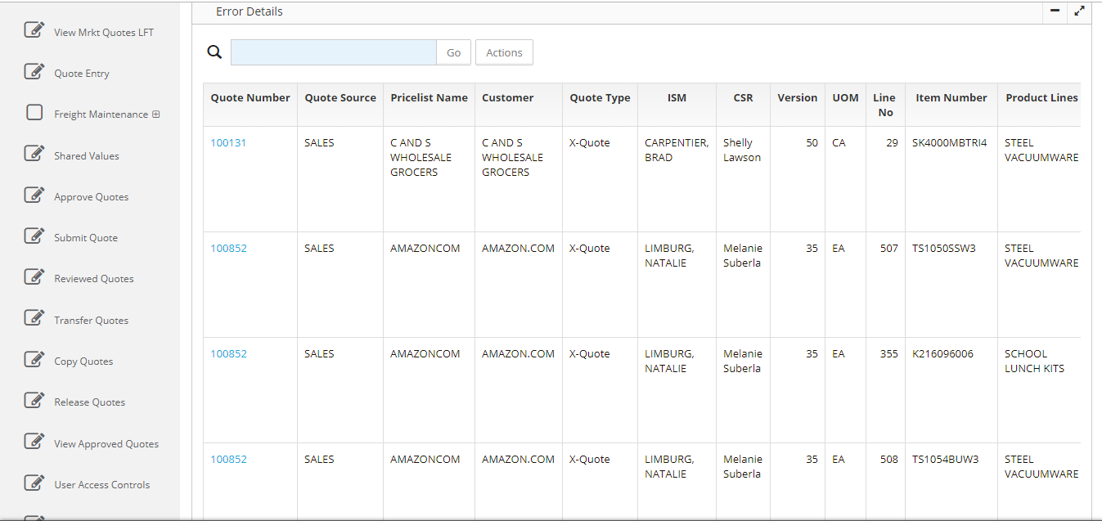
Interface Error Report
Errors while interfacing pricelist data to EBS
Corrections made and interfaced again

Slide 28
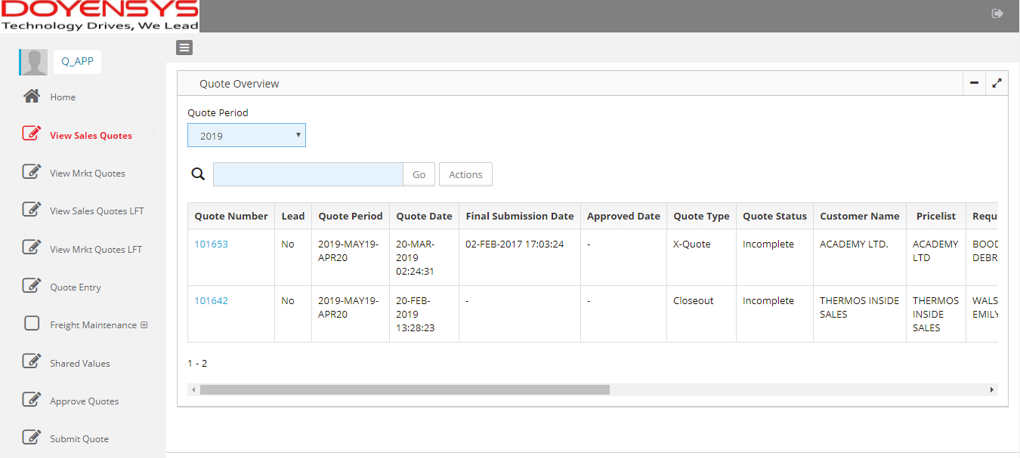
View Quotes Reports
Quotes saved and available for approval process
Bulk data loaded from files

Slide 29
Demo

Slide 30
Conclusion

Slide 31
Business Benefits
Avoid wrong price updates in EBS Pricing
Maintain audit trial for requester & approver for every pricelist
Transparency in pricing
Easy to maintain customer wise
Customer/ pricelist mapping to avoid wrong pricelist updates to Sales Orders
No changes to prices without approval
Notes:
Directly lined to revenue
Maintain revision history of pricelists

Slide 32
Q & A
archana.raghu@doyensys.com
10999

