Slide 1
Bill Presentment Architecture – No More AR Invoice Print Customizations
10852
Template Management, Interactive Preview, External Template Upload
SURYANARAYANA TVNS
PRINCIPAL CONSULTANT
DOYENSYS
05-APR-2019

Slide 2
Presenter Information
Working as Senior Consultant with Doyen Systems Pvt. Ltd. India​
Having 11 years of experience in Oracle Implementation, Upgrade and Product support of various Oracle Applications releases.​
Extensively worked in Finance, SCM, HRMS, Project Accounting and Custom modules. ​
Worked on across the geographical locations and different project challenges.​
varied projects

Slide 3
Winner of Great Indian Workplace 2018
Emerging Enterprises Category
Our People (Based out of USA & India)​
240+ people with expertise in Oracle Fusion, E-Business Suite and Core Oracle Technology​
Qualifications​
91% - Certified Professionals​
PMI - PMP​
MBA / Engineers​
Serving Customers for last 10+ years

Slide 4
Agenda
Challenges - Customizing AR Invoice Print
BPA – Overview
BPA – Advantages
BPA – Process Flow
BPA - Configuration

Slide 5
Challenges In Customizing AR Invoice Print

Slide 6
No Expedite of Payment Nor Improvement of Cash Flow
Any small changes to the AR Invoice Print report is time taking process
MLS Language Enabled but dependent on Function
We Cannot Incorporate Hyperlinks

Slide 7
Overview

Slide 8
Framework for collecting billing data stored in Oracle Receivables
Oracle Order Management and Oracle Service Contracts and other Oracle Services
Legacy systems and other Non-Oracle Applications.
Incorporate billing information from any source, not just Oracle Receivables

Slide 9
BPA Process Flow

Slide 10
Create Supplementary Data Source
Attach the Header and Line Views to Data Source and select template items
Create Header and Line Views
Design the Template Page or Add the External Template
Assign Data Source to Template
Create Template from Template Management
Create Rule
Provide Attribute Matching Criteria
Assign the Template
Interactive Preview

Slide 11
Prerequisites
Bill Presentment Super User Responsibility is Assigned and Accessible
Profile Options
AR: BPA Attachment Update Enabled
AR: BPA Details Access Enabled
AR: Print Attachment Document Category
HZ: Enable DQM Party Search

Slide 12
Configuring BPA

Slide 13
Creating Views
Create Header View
Create Line view

Slide 15
Creating Data Source
BPA supports registering supplementary data source for Oracle Receivables
Oracle Receivables registered as primary data source in BPA

Slide 21
Defining Templates
Create Template and Provide Data Source
The primary page has three content areas
Header
Lines and Tax
Footer

Slide 26
Attaching External Templates

Slide 28
Defining Assignment Rules
Assignment Rule Criteria
Attribute Name
Condition
Value

Slide 29
Notes:
Default Rule
BPA provides default rules that assign the default template by Transaction Class or Format depending on the primary data source selected. For example, it assigns the Default Invoice Template to present invoices. If no rule matches attributes and content item values, it applies one of the two default rules based on your primary data source selection:
Default Transaction Rule: The Default Transaction Rule applies if you selected Oracle Receivables as your primary data source and BPA uses the default template to present the bill. This is true for transactions for all supplementary data sources.
Default Balance Forward Rule: The Default Balance Forward Rule applies if you selected Oracle Balance Forward Billing as your primary data source. BPA applies this rule and assigns the Default Balance Forward Summary Template or Default Balance Forward Detail Template depending on the choice of Format.

Slide 31
Assigning a Template to a Rule
Select the templates that the rule applies to from the list of assigned templates. You must assign a template for at least one transaction class.
BPA filters the available templates based on the supplementary data source, transaction class, and presentment type you select.

Slide 32
Notes:
A bill creation date must be January 1, 1970 or later.
Bill creation dates cannot overlap within a rule. For example, if you assign two templates, Template A and Template B, to a rule, then the bill creation dates for Template A cannot overlap the bill creation dates for Template B.
The Bill Creation From date must be earlier than or equal to the Bill Creation To date.

Slide 33
Interactive Preview

Slide 35
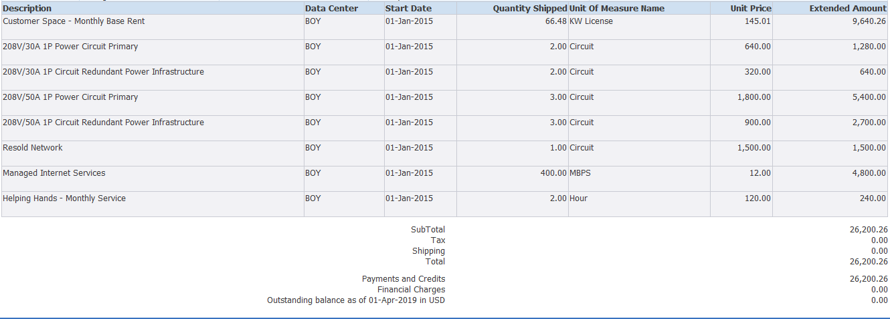
Sample Online Output

Slide 36
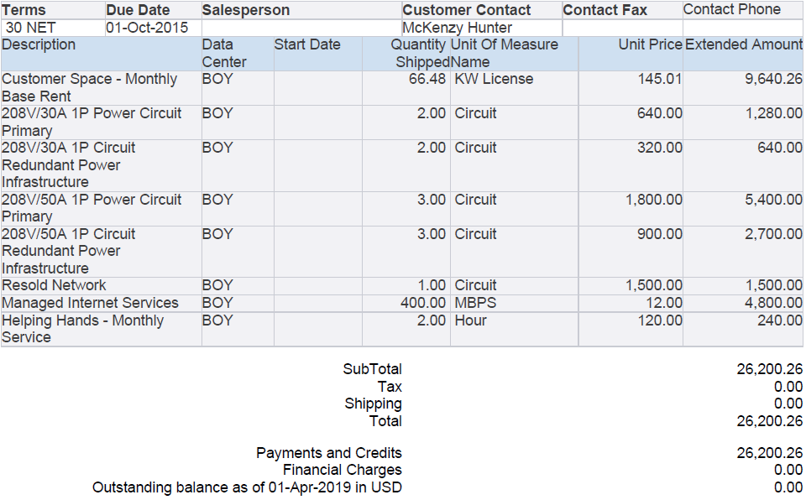
Sample PDF Output

Slide 37
Advantages of BPA

Slide 38
Expedite Payment and Improve Cash Flow
MLS Language Enabled
Flexibility to incorporate Company logo
Template for Transaction Classes other than Invoice
Incorporate Hyperlinks on Online Invoices
Notes:
The invoice designs we create can be assigned to particular customers or particular transactions. This format consistency will help customers process their bills quickly. To efficiently address disputes, billing personnel, receivables clerks, and collectors can view bills in Oracle iReceivables, Oracle Receivables, or Oracle Collections, in the same format the customer sees.
MLS enabled : This is the Biggest advantage is MLS-enabled. Templates can be created using any available session language. When printing bills, BPA selects the appropriate template file based on language associated with customer’s address
Flexibility to incorporate Company logo: Custom images and messages can b

Slide 39
vnss.apps@gmail.com
10852

