Slide 1
Customization Capabilities of Oracle Fusion Cloud: A Developer Perspective
Overview of different customization capabilities available in Oracle Fusion Cloud. This session covers Data & Configuration migration methodologies, Different Customization migration approaches from EBS, Reporting features and its capabilities, SAAS Personalization capabilities and its limitations, Fusion Integration & Web services capabilities , Overview of Fusion mobile apps.
VIMAL MANIMOZHI
PROJECT LEAD
DOYENSYS
14-SEP-2018

Slide 2
Presenter Information
Working as Project Lead with Doyen Systems Pvt. Ltd. India
Oracle Cloud Certified Specialist with around 14 years of experience in Oracle Consulting, Implementation, Upgrade and Product support of various applications releases.
Extensively worked in Finance, SCM, HRMS and Custom modules
Worked on varied projects across the geographical locations and different project challenges.
Presented papers in various OAUG events.

Slide 3
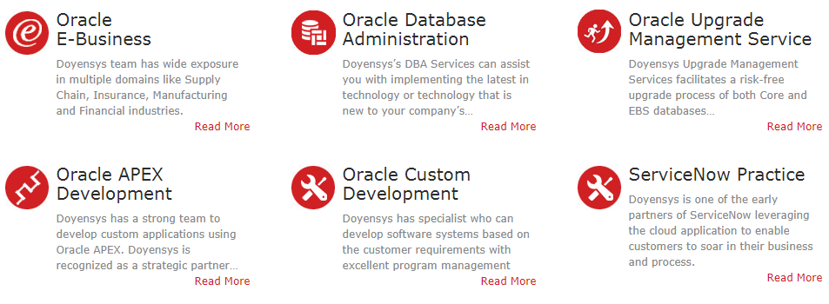
Our People (Based out of USA & India)
250+ people with expertise in Oracle Fusion, E-Business Suite and Core Oracle Technology
Qualifications
91% - Certified Professionals
PMI - PMP
MBA / Engineers
Serving Customers for last 10+ years

Slide 4
AGENDA → Fusion Technology Advances → SAAS Personalization capabilities → Fusion Integration & Web services capabilities → Overview of Fusion mobile apps → Customization migration from EBS

Slide 5
Fusion Technology Advances

Slide 6
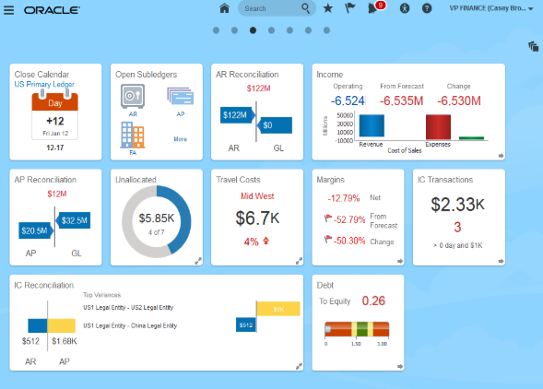
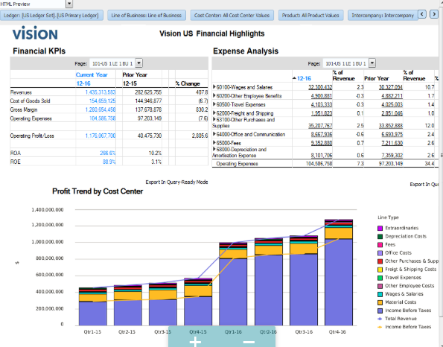
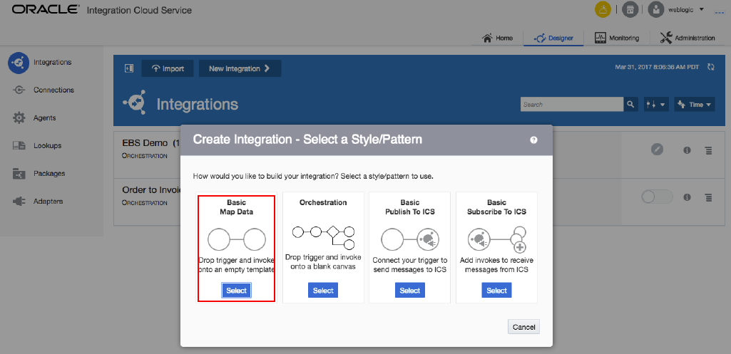
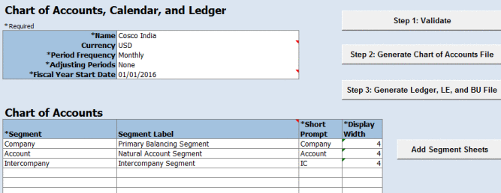
What's There in Fusion Cloud
New UI - Infolets / Dashboard New Reporting Tools
New Integrations New Configuration Tool

Slide 7
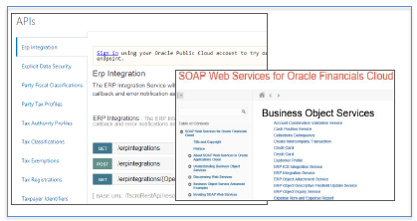
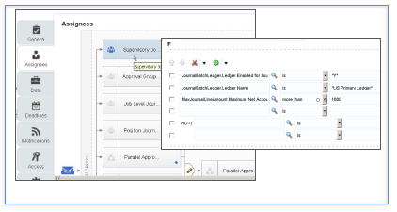
What's There in Fusion Cloud
New Integrations Configurable Workflow

Slide 8
Technology & Changes
Technology | EBS | Fusion Cloud
Servers | Oracle Apps Server | Oracle Weblogic
GUI | Forms, JSP, OAF | Oracle ADF, ADF Java Server Faces
Workflow | PL/SQL | BPEL(Business Process Execution Language)
Reports | RDF/XML Publisher | BI Publisher
Analysis | Discoverer | OTBI(Oracle Transactional Business Intelligence)
Access | Responsibilities | Roles
Approvals | AME/Workflow | BPEL/BPM(Business Process Management)
Data Migration | Conversion | FBDI(File Based Data Import), WebServices
Setup/Configuration | Application | FSM(Functional Setup Manager)
Application Development | NA | Visual Builder- To Build Integrations, Extensions, Reports. Support Mobile & Voice UI

Slide 9
Fusion Application – Technology Advances
What’s New | Benefits
Web based intuitive screen design | Reduce training efforts
Task driven workbench and Infolets | Improve productivity
Personalization capability | Improve agility
Mobile Apps for Transaction and Partners | Improve employee mobility and productivity/ Digitally connected to external parties
Transactional BI | Ad-hoc reports capability
Financial Report | Selectable point of views with drill-down capability
Excel Smart View | Slice and dice data for business analytics
Formatted Report | Formatted report with graphical presentation
Transactional dashboard | Provide key metrics
Accessible by managers &department users | Encourage direct accountability
Comprehensive FBDI templates | Improve and automate data entry tasks, reduce IT built costs
New Data APIs | Enable real-time data integration especially for client apps
New SOAP web services | Enable system integration with external applications
Configuration templates | Timesaver configuration tools
Comprehensive documentation | A centralized documentation repository improves accessibility to essential documents
Downloadable templates | Instant download for templates from web site or within applications
BPM Workflow (AMX) | Re-configurable Seeded workflow, Flexible rules to allow business simplification

Slide 10
Skill Requirement For Fusion Consultant
Inhouse IT as well as Consulting companies need below skill to extend, maintain and support the various components of Oracle Fusion Applications
SQL, PL/SQL, JAVA & java script
XML – Extended Markup Language
CSS – Cascading Style Sheets
XSL – Extensible Style sheet Language
ADF – Application Development Framework
JSF – Java Server Faces
Web Services, Web Center
BPEL – Business Process Execution Language
BI Publisher
Hyperion Essbase
WebLogic Server Administration

Slide 11
SAAS Personalization capabilities

Slide 12
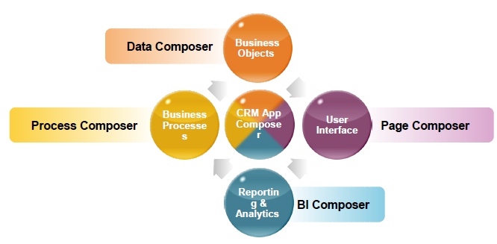
Oracle’s Family of Composers

Slide 13
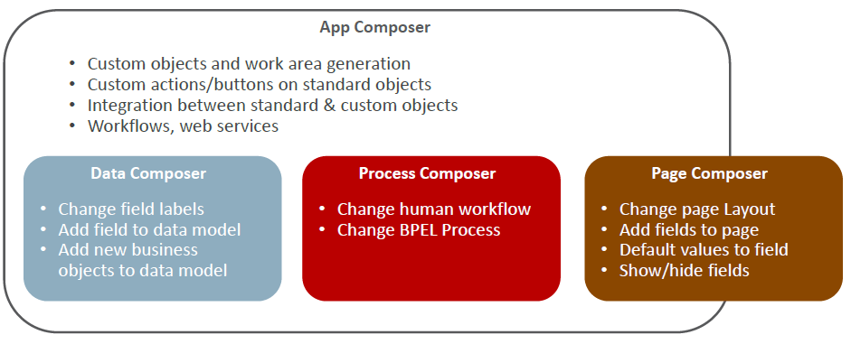
Oracle’s Family of Composers

Slide 14
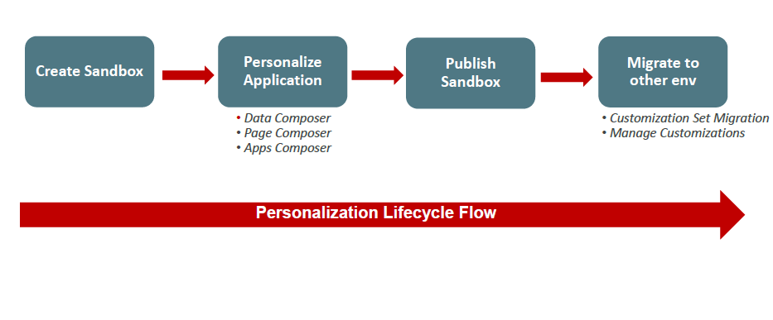
Personalization Life Cycle

Slide 15
Customization Scenarios
Below are scenarios for which you can customize and extend Oracle Fusion
Page customization
Branding customization
Object customization
Business process customization
Security customization
Business intelligence customization
Help customization

Slide 16
Customization Scenarios

Slide 17
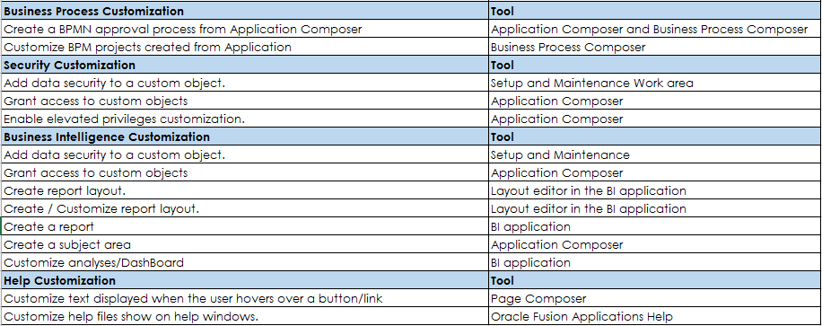
Customization Scenarios

Slide 18
Fusion Integration & Web services capabilities

Slide 19
Fusion Cloud –Connectivity Capabilities
Inbound Connect
•File Based Data Import
Outbound Connect
•Events and Notification
•BI Publisher / BICC
•SaaS extracts
•Real-time
•SOAP/Rest Web services
•Batched based

Slide 20
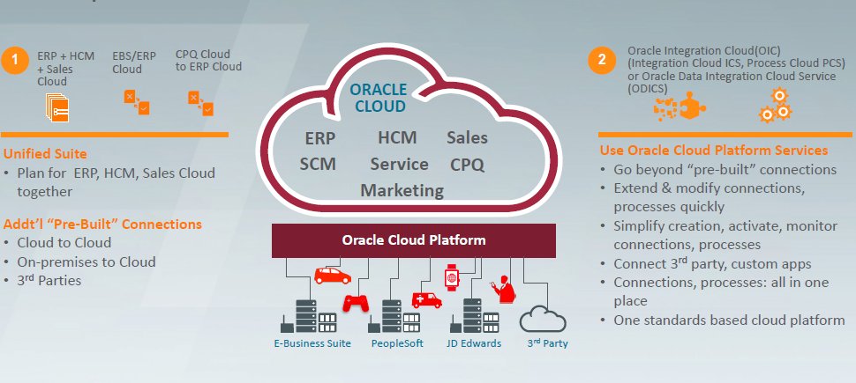
Options to Connect ERP/SCM Cloud

Slide 21
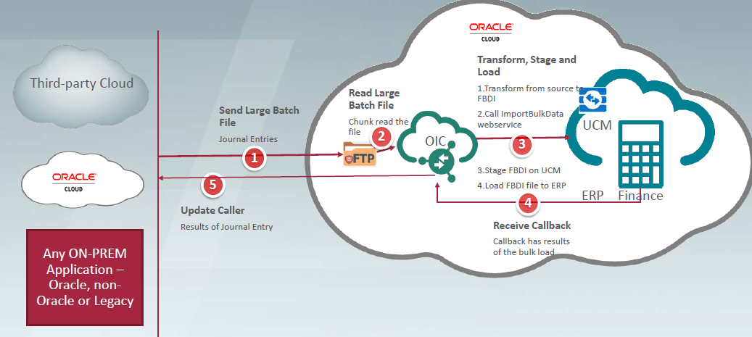
FBDI using OIC

Slide 22
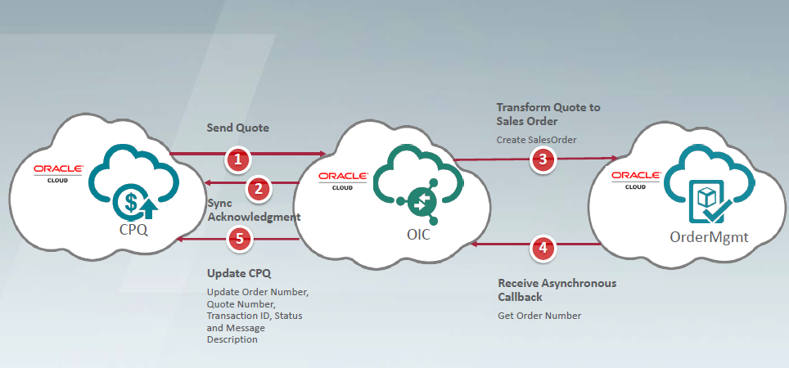
SOAP/REST Web services Using OIC

Slide 23
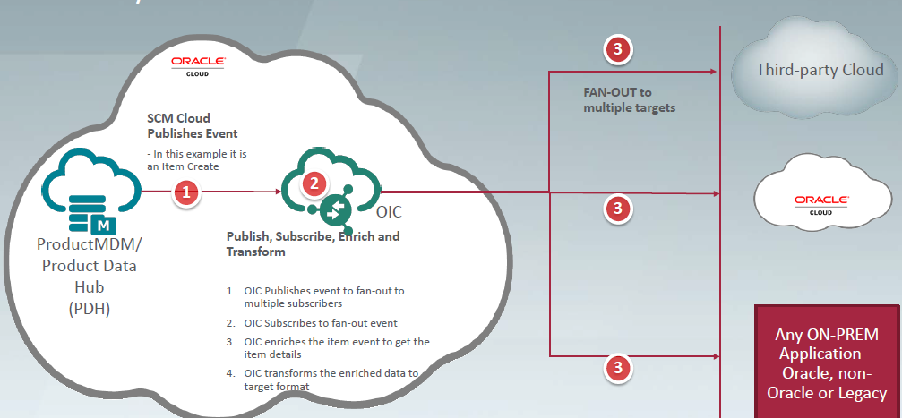
Event & Notifications

Slide 24
EBS – Fusion Integration

Slide 25
EBS – Fusion Integration

Slide 26
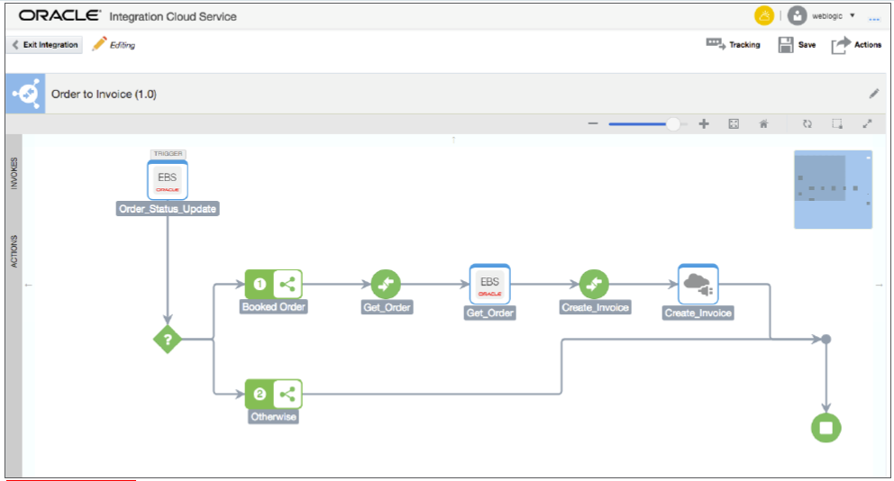
Example Integration Scenario

Slide 27
Reporting features and its capabilities

Slide 28
Fusion Reports
SAAS Extracts
SAAS Extract is a flexible tool for generating data files and reports.
Extracts can deliver data in various formats such as PDF, Excel, Word, CSV, HTML, XML etc.
OTBI
Build rich, visual and interactive reports and publish to multiple users.
Create reports using real time transactional data.
Easy for business users to access, analyze, and use the transactional information.
Perform self- service, ad-hoc analysis.
60+ canned reports
BI Publisher
Reports can be created using web browser or familiar desktop tools
Supports multiple output formats (such as PDF, CSV, XLS)
Pixel perfect reports

Slide 29
Key Features Of Fusion Reports
Define the folder the report should reside – My Folder, Shared folder, Custom folder
All custom objects in stores custom folders
Determine the template to be used – RTF, XPT, EText
Different layouts and Output formats available.
Pre-built reports can be reused- Variety of pre-built reports available.

Slide 30
Fusion mobile apps

Slide 31
Fusion mobile apps

Slide 32
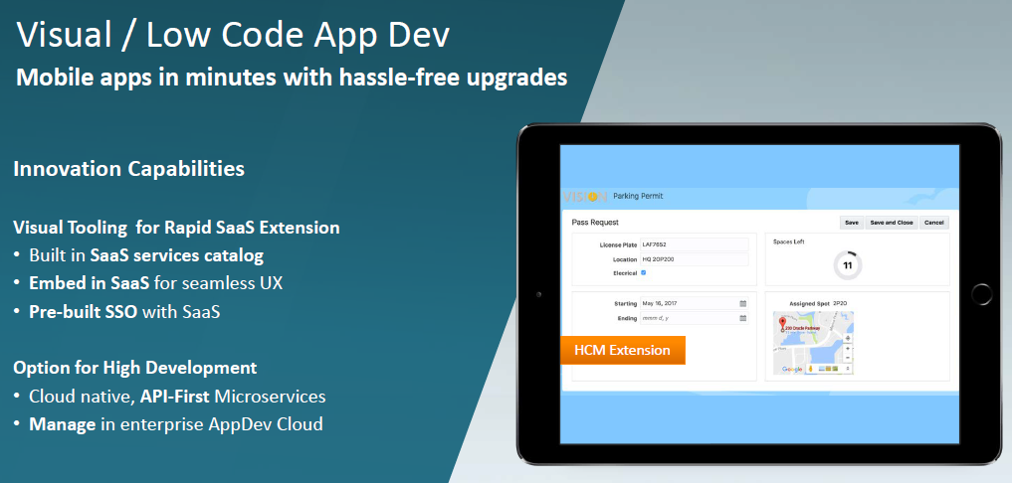
Fusion mobile apps

Slide 33
Customization migration from EBS

Slide 34
Manual Migration from EBS
Extract and Cleanse master & transaction Data, Use FBDI Templates for Onetime load
Download Configurations , Convert to Rapid implementation Templates and Load
Reuse Report queries/templates to Build BI & OTBI reports
Standardize Form and OAF personalization to SAAS model.
Convert Workflow Rules and Approval groups in Template and load for On time
Consider PAAS access if custom business flow not adopt with SAAS extension

Slide 35
References
E-Business Suite 12.2.7 Upgrade - A Comprehensive Methodology and Roadmap – OAUG Collaborate-18
Oracle Fusion Cloud Vs EBS 12.2.7 Upgrade: What suits your business best - TLOAUG
Functional Advances and Benefits of Fusion Cloud Modules – Quick Reference
Oracle Fusion Cloud Migration: Quick Technical Reference

Slide 36
Questions and Answers vimal.manimozhi@doyensys.com https://www.linkedin.com/in/vimalathithanm

