Slide 1
E-Business Suite 12.2.7 Upgrade - A Comprehensive Methodology and Roadmap
10419
VIMALATHITHAN M
PROJECT LEAD
DOYENSYS
New features and enhancements of Key process/modules, Innovative Migration & Cutover strategies, Case studies, Lessons Learned and Migration to Cloud
21-AUG-2018

Slide 2
Presenter Information
Working as Project Lead with Doyen Systems Pvt. Ltd. India
Oracle Cloud Certified Specialist with around 14 years of experience in Oracle Consulting, Implementation, Upgrade and Product support of various applications releases.
Extensively worked in Finance, SCM, HRMS and Custom modules
Worked on varied projects across the geographical locations and different project challenges.
Presented papers in various OAUG events.
Vimal

Slide 3
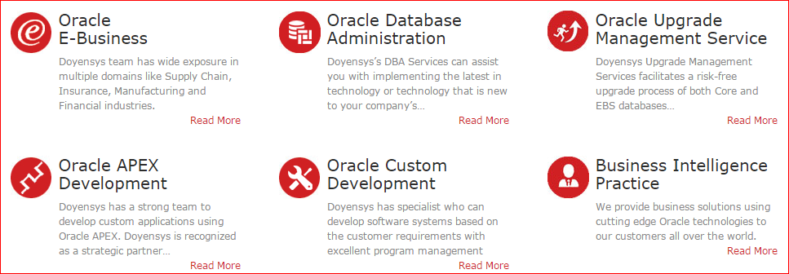
Our People (Based out of USA & India)
240+ people with expertise in Oracle Fusion, E-Business Suite and Core Oracle Technology
Qualifications
91% - Certified Professionals
PMI - PMP
MBA / Engineers
Serving Customers for last 10+ years

Slide 4
AGENDA →EBS Upgrade - Key Considerations →New Features and Enhancements of EBS 12.2.7 Releases →EBS Roadmap →Migration & Cutover strategies →Case studies & Lessons Learned →EBS Upgrade Approach

Slide 5
EBS 12.2.7 Upgrade - Key Considerations
Enhancements & Business Process Change
Business Adoption
Project Timelines
Value Addition to Business
Oracle Road Map & Support
Implementation Approach
License & Cost

Slide 6
New Features / Enhancements - Applications Technology - Oracle Financials - Oracle SCM

Slide 7
Applications Technology
Online Patching
Allowed Resources stores in the database rather than in configuration files
Concurrent Processing Log /Output Files - organized by user name or by date
External Integrations - Integration with Oracle Web Center Portal and Oracle BPEL Process Manager
EBS – SOA Gateway→ WebLogic Server 11g with SOA Suite 11g Integration.
Oracle XML Gateway - process inbound messages either in Java or in PL/SQL
Internationalization- Lightweight Language Support
Personalization Workbench
Register & Search KFF & DFF in OAF
Audit Trail Search in HTML UI
API to Manage Trading Partners In addition to using the Forms-based UI page

Slide 8
Payables & Receivables
Oracle Payables
Workflow Transfer of Approval to another user Vs delegation
Workflow Parallel Approval of Supplier Invoices
Payment Acknowledgement Import
International Bank Account Number (IBAN) Support for Customer and supplier bank accounts
Oracle Receivables
Accounting Exceptions during Period Close
Automate Auto Lockbox Processing through a standard concurrent requests
Mask Tax Payer Identification and Tax Registration Number from Customer Name list of values
Recognize Revenue Based on Fair Market Value with Fusion Revenue Management Integration

Slide 9
Oracle GL & Others
Oracle GL & Others
EBS GL Integration with the Fusion Accounting Hub - Transfers Fusion journals to record EBS period balances, and ability to drill-down from Fusion to EBS.
Data Relationship Management (DRM) Integration with EBS- Synchronizes each EBS instance with Hyperion DRM, It store COA values and child-parent relationships
WebADI Control Account Usage Restriction & Enhancements
Adv Collections- Assign collectors at multiple collection levels
EBS Tax- Customer Tax Information Import→ To Load Party Tax Profile, Tax Registrations, Exceptions and Reporting Codes
Journal Approvals Integration with Oracle Approvals Management and Oracle Workflow
Scheduling of AP/AR Netting Batches - Allows automatic creation and settlement of netting AP & AR batches

Slide 10
Order Management
Oracle Order Management
Service Item Support in Promotional Modifiers
Support of Non-Continuous Price Breaks and allow gaps
Tax Calculation on Freight Charges in OM instead of AR
User Defined Attributes (UDA) - To add several additional fields to the order header and line.
Credit Tolerance for Honoring Manually Released Credit Check Holds
Excluding Reserved Lines from Scheduling
Scheduling Enhancements
Partial Available Qty->Split & Schedule/Split & Substitute
Order Fulfillment based on the Secondary UOM
Item Substitution and Manual Line Splits on Internal Sales Orders
Integration OM with AME
HTML User Interface for Order Management

Slide 11
Purchasing & Inventory
Oracle Purchasing & iProcurement
Visibility of Item Master Attachments in Item Search
One-Step Checkout- View shopping cart & submit the requisition with a single click.
Support for Foreign Currency in Catalog Request
Spot Buy Purchases Privileged Requesters- Convert Req to PO, New Supplier Creation
Web service for importing requisitions
Extension Hooks for Additional custom validations in PO
Create or modify purchase order lines using Spreadsheet/Web ADI
Notification to Requester when requisition converted to PO
Oracle Inventory
Return to Vendor enhancement
Create in AR and track in Shipping
Request without a PO
Return material from any warehouse
Public APIs for UOM
Transaction Status Summary window for Receiving Open Interface (ROI) transactions
New HTML User Interfaces for Receiving , Shipping & Reservations

Slide 12
EBS 12.2 Key Enhancement By Product Family

Slide 13
EBS Road Map

Slide 14
EBS Roadmap

Slide 15
EBS Investment & Roadmap

Slide 16
EBS New UI & Mobile Apps

Slide 17
EBS Mobile Apps

Slide 18
EBS On Cloud

Slide 19
EBS On Cloud

Slide 20
EBS 12.2.7 – Adoption Choices

Slide 21
EBS & Fusion – Adoption Choices

Slide 22
Practical Coexistence of EBS & Cloud Application

Slide 23
Migration & Cutover Strategies

Slide 24
Migration & Cutover Strategies
CEMLI - Upgrade Analyzer Tool
Configuration Migration Tool
Object Migration technique
Live data integration during cutover

Slide 25
db IMPACT
Evaluation of existing customizations and estimating the effort
A tool which provides detail assessment on CEMLI.
The major features and advantages of this application:
Lists all custom objects in Oracle EBS 11i/R12 existing release
Impact analysis of all custom code migration to R12 target release
Effort estimate on migration to new R12 target release
Suggesting how the impacted custom code can be migrated to R12 target release
Tracking the status of the custom code migration
Upgrade Impact Statistics will be available over the cloud and can be tracked for completion

Slide 26
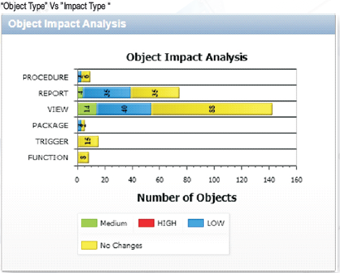
db IMPACT

Slide 27
db IMPACT

Slide 28
db IMPACT

Slide 29
Configuration Migration
Challenges involved in Up-Gradation Projects
Identifying the sequences of configuration steps to be followed
Ensure the dependency task completion
Manual Efforts involved for each configurations
Different migration methods to be identified and followed (Manual, Data Loader, SQL loader and Web-ADI)
Maintaining software licenses for different migration tool
Ensure the correctness and accuracy of configurations
Ensure the change management or incremental configurations retrofitted to the further phases of Project

Slide 30
Configuration Migration
Config Snapshot - Major features and advantages of :
Automatically create setup documentation
Migrate setup from one instance / entity to others- Compare operating units, sets of books etc. within an environment and across environments
Compare setup across different versions of the E-Business Suite when upgrading / reimplementing
Create date stamped copies of setup (baselines) enabling historic reporting and comparison over time
Differentiate implementation and seeded data
Full audit change tracking, Segregation of Duties conflict reporting
Present complex data in simple context-based reports simplifying system administration

Slide 31
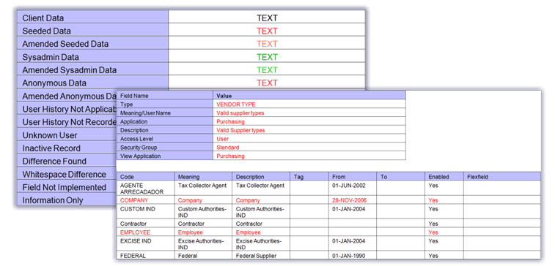
Configuration Migration
Documentation

Slide 32
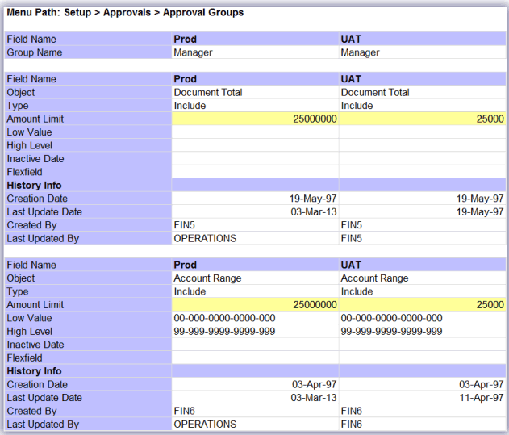
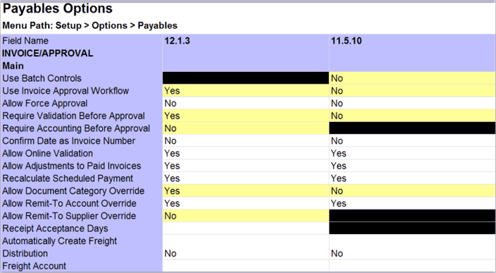
Configuration Migration
Compare

Slide 33
Cutover Strategies
Object Migration technique
Shell Scripts for Object Compilation
FND Load for AOL Migration
Live data integration during cutover
Interface with lower instance
Conversion from lower to higher instance

Slide 34
Case studies & Lessons Learned

Slide 35
Case studies & Lessons Learned
Case 1: 11.1.3 to 12.2 Upgrade with 3K Custom Objects
Over 3000 Custom Objects has been upgraded which includes following
DB Objects -2600
Concurrent Programs-820
Forms-100
Forms Personalization-320
Workflow-6
AOL Objects-400
OAF Personalization-10 Pages
Critical business transactions allowed to happened during cutover, Data converted to R12 after Go-Live.
Size of 2TB Database has been upgraded along with application upgrade
Post Upgrade support given for more than 400 users and 50 organizations.
Object Upgrade, Testing and Migration done for 3 Dev instances and 2 UAT instances before Prod Upgrade

Slide 36
Case studies & Lessons Learned
Case 2: 12.2 Upgrade with Multiple OU & Org
Over 500 Custom Objects upgraded along with many new report development
Size of 6TB Database has been upgraded along with application upgrade
Rollout of more than 70 countries/ organizations with new customizations and different functional setups

Slide 37
EBS 12.2 Upgrade Approach
1
EBS Lift & Shift to Cloud
2
Upgrade Patching
6
Prod Cutover Strategies & Support Transition
3
4
Functional Setup Changes & Migration
Customization Remediation and its Migration
5
Testing, Reconciling & Training
Notes:
Online Patching- It uses the Oracle Database 11g Release 11.2.0.2 feature of edition-based redefinition to reduce significantly the downtime
Patching Support single file system--online patching environment requires two application tier file systems, one for the run edition and another for the patch edition. This enables to have a development environment with where custom code can be built and tested in a single file system.
Seed Data Change-During an online patching cycle, a copy of the “run rowset” is maintained, so that patching data rows does not affect the running application. Whenever an online patching cycle starts and seed data needs to be patched, a new copy is generated from the run copy, and the old copy is deleted during cleanup.
Lightweight language- Allows EBS to support languages without providing translations or NLS patches. It allows users to enter data in the given language and generate reports in that language using the English UI.

Slide 38
Other References
Oracle Fusion Cloud Vs EBS 12.2.7 Upgrade: What suits your business best
Advances and Benefits of Fusion Cloud Modules – Quick Reference

Slide 39
Q & A
vimal.manimozhi@doyensys.com
https://www.linkedin.com/in/vimalathithanm

