Slide 1
Extended Features of OAF - Efficient Interfacing & Reporting
Archana Raghu PMP®/ Jilani Basha
Doyen Systems Pvt. Ltd.

Slide 2
Presenter(s) Info
Archana Raghu
Project Lead - EBS, Doyen Systems Pvt Ltd
12+ Years of experience in Oracle technologies like EBS, PL/SQL, OBIEE, APEX, ADF etc.
Certified Project Management Professional PMP® and worked on several projects focusing on conceptualizing business needs and translating them into viable technical solutions.
Successful analysis and problem-solving expertise and proven project management experience.

Slide 3
Presenter(s) Info
Jilani Basha Shaik
Technical Consultant, Doyen Systems Pvt Ltd
Technical Consultant in Oracle E-Business Suite with 6 years of experience
Part of multiple Oracle E-Business Implementation & Upgrade projects with a focus on configuration, development and support of Oracle Applications
Worked on several OAF personalization and customizations.

Slide 4
Agenda
Introduction
Case Study
Layout Design
Technical Approach
Pros & Cons

Slide 5
Introduction

Slide 6
Introduction
EBS Framework for application development
Web Based pages with BLAF
Visual and declarative approaches to JEE
Developed using Jdeveloper Tool
Seeded Pages can be personalized & customized
New Page development

Slide 7
Architecture
Client- Tier
Application- Tier
Database-Tier
HTTP Request
Model
Data Base
Controller1, 2,3, 4 … n
A
M
VO
WEB CLIENT
View
EO
HTTP Response
JDBC

Slide 8
Architecture

Slide 9
Features of OAF

Slide 10
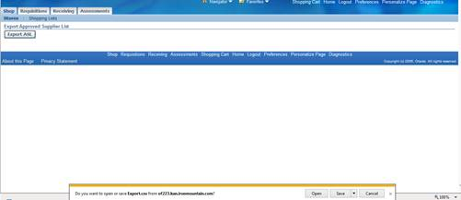
Features of OAF - Interfacing
Export Button:

Slide 11
Features of OAF - Interfacing
Import Button

Slide 12
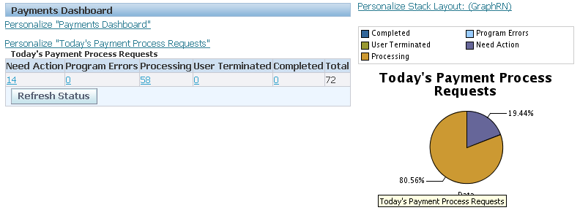
Features of OAF - Reporting
Display Graphs

Slide 13
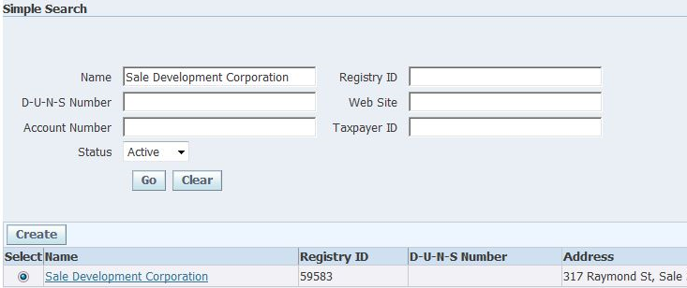
Features of OAF - Reporting
Report output in same page

Slide 14
Features of OAF - Reporting
Links for Navigation/ Submitting Requests

Slide 15
Case Study

Slide 16
Business Requirement
Bulk Update of Purchase Orders in iSupplier
Send bulk acknowledgement back to buyer
Increase Efficiency of business process
Reduce manual work

Slide 17
Standard Process

Slide 18
Customized Process

Slide 19
Process Description
Process | Description
Process 1 | Input: Purchase Orders require Acknowledgement Output: Excel Template with detailed list of eligible Purchase orders
Process 2 | Input: Excel Template with detailed list of eligible Purchase orders Output: Excel Update with Appropriate Action and Comments
Process 3 | Input: Excel Template Output: Excel Template Upload
Process 4 | Input: Batch Processing based on Excel Template Data Output: Purchase order Acknowledgement with Accept/Reject Comments.

Slide 20
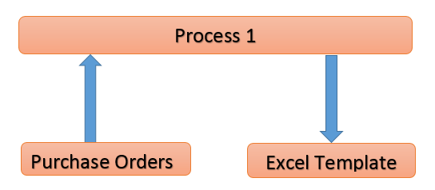
Process 1 – PO Ack
Purchase Orders require Acknowledgement.
Excel Template with detailed list of eligible Purchase orders.

Slide 21
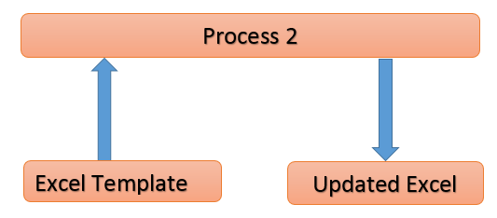
Process 2 – Download Excel
Excel Template with detailed list of eligible Purchase orders
Excel Update with Appropriate Action and Comments

Slide 22
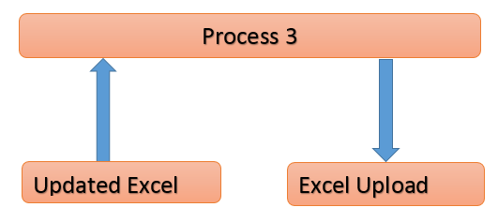
Process 3 – Upload Excel
Excel Template download
Excel Template Upload with updated data

Slide 23
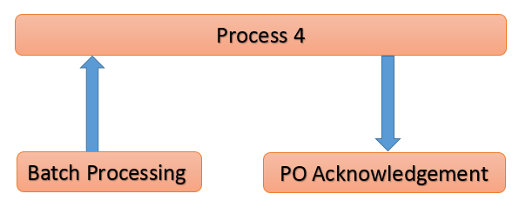
Process 4 – Batch Output
Batch Processing based on Excel Template Data
Purchase order Acknowledgement with Accept/Reject Comments.

Slide 24
Layout Design

Slide 25
Form layout – Seeded Page
A New Button added to isupplier portal page

Slide 26
Form layout – Custom Page

Slide 27
Technical Approach

Slide 28
Steps to be followed
Bulk Acknowledgement Button
Upload page Structure
Export Button
Import Button
Cancel Button

Slide 29
Bulk Acknowledgement Button

Slide 30
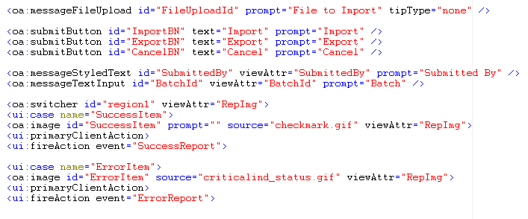
Process - Step 2

Slide 31
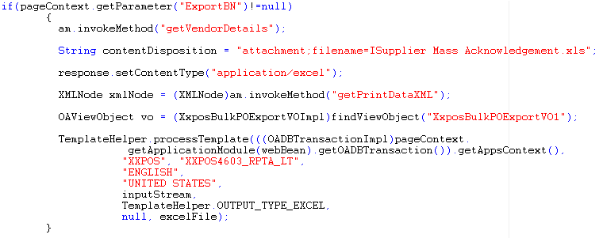
Process - Step 3

Slide 32
Step 3- Output

Slide 33
Process - Step 4

Slide 34
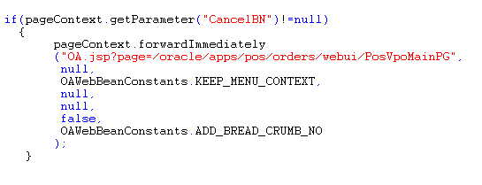
Process - Step 5
Cancel Button Logic

Slide 35
Pros & Cons of OAF
Browser based
Integration with mobile devices.
Light weight component
Better look and feel as compared to forms
Can be used only with oracle database.
No drag & drop option.

Slide 36
Q & A

Slide 37
Thank You

