Slide 1
Interactive Mobile App For All your workflow needs – A case study
Archana Raghu PMP®/ Sibi Elamparithi
Doyen Systems Pvt Ltd
DEC-2018

Slide 2
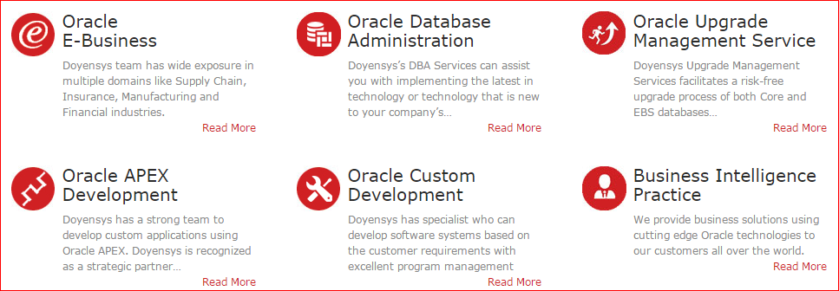
Our People (Based out of USA & India)
240+ people with expertise in Oracle E-Business Suite and Core Oracle Technology
Qualifications
91% - Certified Professionals
PMI - PMP
MBA / Engineers
Serving Customers for last 10+ years
Notes:
Our company was founded in 2006 in both US and India. We have 200+ employees and work primarily on Oracle technologies. We provide Oracle based solutions to our customers using a process driven global delivery model.

Slide 3
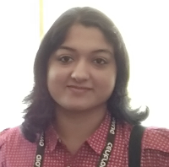
Presenter Info Archana Raghu
13+ Years of experience in Oracle technologies like EBS, PL/SQL, OBIEE, APEX etc.
Certified Project Management Professional PMP® and Certified Cloud Procurement 2017 Specialist
Worked on several projects focusing on conceptualizing business needs and translating them into viable technical solutions.
Presented papers in OAUG Collaborate held at Las Vegas, USA in April 2017 & 2018, Sangam AIOUG Dec 2017.
Notes:
working as a Project Lead in Doyen Systems Pvt Ltd. I’m a PMP® certified Oracle professional with 13+ years of experience in Oracle technologies like EBS, Apex, OBIEE etc.

Slide 4
Presenter Info Sibi Elamparithi
2+ Years of experience in Oracle technologies like SQL,PL/SQL, APEX etc
Oracle Certified Associate 12C
Worked on several projects from front-end user interface design, to back end relational data base design and development.
Have good experience in understanding business requirements and providing appropriate technical solutions
Notes:
Considerable experience in developing mobile apps using Oracle Apex

Slide 5
Introduction to Mobile App
Why Custom Mobile App?
Why Apex?
Framework for Workflow
Interesting Features of App
Conclusion

Slide 6
Introduction to Mobile Apps

Slide 7
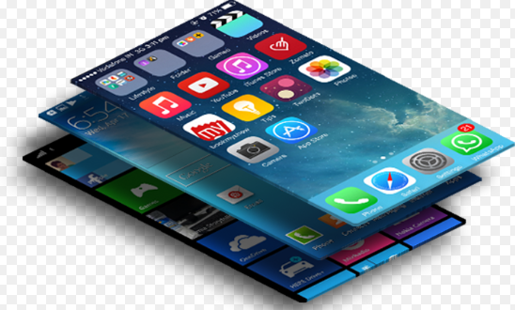
Mobile apps - Introduction
EBS Smartphone application – Enterprise Mobility
Changes the way organizations do business and engage with the customers.
Allows access for enterprise information anywhere, anytime using any device.
Simplification – convert complex work to actual business needs.
Effective and Efficient way to complete tasks.
Built-in functionalities for day-to-day activities.
Notes:
Day-to-day activities including creating transactions and approvals

Slide 8
Adv of using Mobile apps
Easier access to information.
Efficient data capture
Enhanced visibility and monitoring
Improved Productivity
Reduced corporate expenses
Automate field sales/ service operations
Notes:
Top management on travel – mobile apps can be handy
Field sales/ service personnels can effectively use mobile apps.
Because of overall improvement in the efficiency, the expenses are reduced

Slide 9
EBS Approvals
Payables Invoices
Internet Expenses
Purchase Requisitions
Collections
Journal Entries
Credit Memos
Payables Invoices
Internet Expenses
Purchase Requisitions
Collections
Journal Entries
Credit Memos
Notes:
Any/ All workflow process will be supported by our app
Apart from the standard modules like AP, AR, GL, there are custom modules and custom workflows implemented by many enterprises. Our mobile app will also work for all those scenarios.

Slide 10
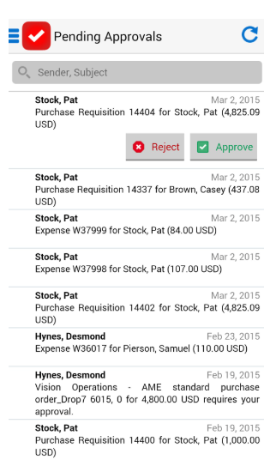
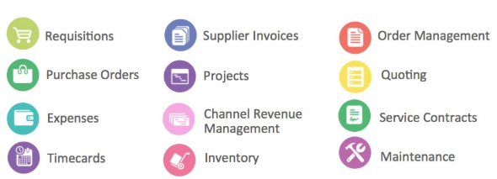
EBS Approvals APP
Notes:
Any/ All workflow process will be supported by our app
Apart from the standard modules like AP, AR, GL, there are custom modules and custom workflows implemented by many enterprises. Our mobile app will also work for all those scenarios.

Slide 11
Why Custom Mobile Apps

Slide 12
Why custom Mobile Apps
Oracle seeded mobile apps available for approvals from EBS 12.1.3
No server side config required
Supports standard modules where seeded app not available
No effort for future workflow implementations – automatic support

Slide 13
Benefits of Custom App
Can be used for any version of EBS
Cost effectiveness
Adaptability
Maintenance
Support for all workflow processes
Notes:
Flexibility - Application can be changed easily to suit your requirements as and when required provided since it is custom made.
Adaptability - Organizational processes change with time, and as the market dynamics change, it becomes necessary to adapt to new processes and technologies to maintain your marketing strong.
Maintanance - Custom applications are maintained as long as you need them
Cost - you are likely paying for features and functionality your business does not use
EAP - have a Google G Suite, LDAP Server or other means of authentication,we can let users log in via those.

Slide 14
Why APEX

Slide 15
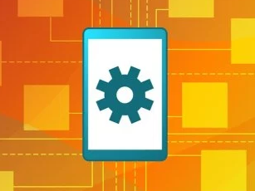
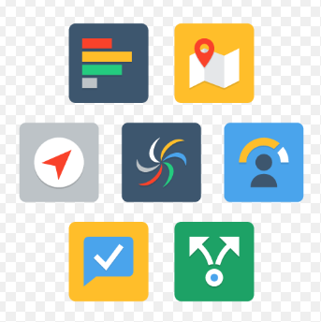
Touch gestures
Tap & double tap
Press
Swipe
Notes:
Touch based dynamic actions – Mobile app UI introduced in Apex 18
Give examples for each action – when to use in mobile app

Slide 16
WHY apex?
Create rich and functional mobile application.
Faster development – Easier Deployment
Easier to lean and adopt – seamless integration with EBS
Cost-effective and simplified solutions for business requirements.
Run on any mobile device with modern browser.
Supports touch based dynamic actions
Customizable charts, gauges, themes etc.

Slide 17
WHY APEX?
Social authentication – Google, FB, Twitter
JET Charts for Dashboards
One app for all devices – desktop, tablets, mobiles
Support for Multiple Authentication Schemes
Responsive Design for Optimal Viewing
Notes:
1) Oracle Seeded Mobile AppliCation Supports only Oracle E-Business Suite Release versions 12.1.3 and above.
2)
3) Can have multiple Modules winding up into a Single application.
Responsive - Same on Desktop, Tablet and Smartphones

Slide 18
Framework for workflow approvals

Slide 19
Workflow approval challenges
Timely approval of key processes – impact business operations
Not being connected to the system – cause delays
Missing early payment discounts
Missing compliance requirements or non-compliances
Notes:
Oracle Standard Approvals App works for 12.1.3 and 12.2

Slide 20
Mobile app for approvals
Combined Reporting and workflow features
Approvals for all workflows – standard and custom
Can be used by all users for approvals
Functionality to handle all future workflow implementations
No effort required on the mobile app for any changes/updates
Notes:
Bulk approve/ reject feature

Slide 21
interesting features OF APP

Slide 22
Interesting Features
Maintenance free.
All Modules/ versions Supported.
Supports real-time data integration with any version of EBS.
Combined reporting and workflow features
All approvals under one roof
Future ready
Notes:
Approvals will be listed in a report, So that Users can have a glance of all Approvals at once.
Module Support - Supports Modules Support which are supported in Oracle Seeded App and additional Modules which are not supported.
Mobile Phone - Build secured cell phone programs with end-to-end protection on a proven platform.
Multi Platform -several mobile phones and techniques such as iOS and Android.

Slide 23
Demo – custom approvals app

Slide 24
Conclusion
Real time scenarios – material issues, PO receipts, stock scanning/ field sales/ field service.
Reduced duplication of data entry.
Improved accuracy and timeliness of transactions.
New functionalities/ custom modules/ custom pages
Ability to attach additional information – more details such as Images & Documents

