Slide 1
Oracle Fusion Cloud Vs EBS 12.2.7 Upgrade: What suits your business best
Process/Functionality - Similarities and differences , Key Consideration before making the choice, How oracle fusion suits to your business, How smooth the transition will be, Case studies with Business benefits
VIMAL MANIMOZHI
PROJECT LEAD
DOYENSYS
14-SEP-2018

Slide 2
Presenter Information
Working as Project Lead with Doyen Systems Pvt. Ltd. India
Oracle Cloud Certified Specialist with around 14 years of experience in Oracle Consulting, Implementation, Upgrade and Product support of various applications releases.
Extensively worked in Finance, SCM, HRMS and Custom modules
Worked on varied projects across the geographical locations and different project challenges.
Presented papers in various OAUG events.
Vimalathithan M

Slide 3
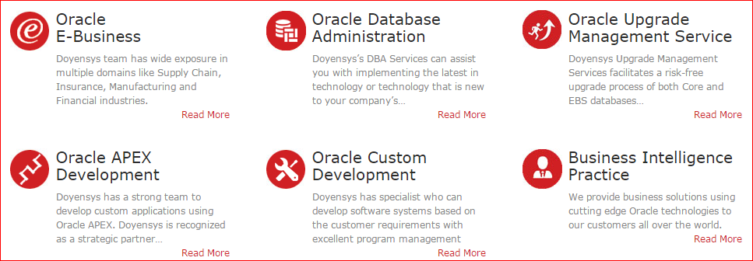
Our People (Based out of USA & India)
240+ people with expertise in Oracle Fusion, E-Business Suite and Core Oracle Technology
Qualifications
91% - Certified Professionals
PMI - PMP
MBA / Engineers
Serving Customers for last 10+ years

Slide 4
AGENDA → Key Considerations for Functional Decision →New Features and Enhancements of EBS 12.2 – 12.2.7 Releases → EBS Roadmap and Value Of R12 Upgrade → Fusion Application and Its Advances → The Transition to Fusion Cloud → Technology Adoption – EBS & Fusion Application → What Suits Your Business Best

Slide 5
Fusion Cloud Vs EBS 12.2.7 Upgrade - Key Considerations
Enhancements & Business Process Change
Business Adoption
Project Timelines
Value Addition to Business
Oracle Road Map & Support
Implementation Approach
License & Cost

Slide 6
New Features and Enhancements of EBS 12.2 – 12.2.7 Releases

Slide 7
EBS Enhancements - Application Technology
Online Patching
Allowed Resources stores in the database rather than in configuration files
Concurrent Processing Log /Output Files - organized by user name or by date
External Integrations - Integration with Oracle Web Center Portal and Oracle BPEL Process Manager
EBS – SOA Gateway→ WebLogic Server 11g with SOA Suite 11g Integration.
Oracle XML Gateway - process inbound messages either in Java or in PL/SQL
Internationalization- Lightweight Language Support
Personalization Workbench
Register & Search KFF & DFF in OAF
Audit Trail Search in HTML UI
API to Manage Trading Partners In addition to using the Forms-based UI page

Slide 8
EBS Enhancements - Oracle Financials
Oracle Payables
Workflow Transfer of Approval to another user Vs delegation
Workflow Parallel Approval of Supplier Invoices
Payment Acknowledgement Import
International Bank Account Number (IBAN) Support for Customer and supplier bank accounts
Oracle Receivables
Accounting Exceptions during Period Close
Automate Auto Lockbox Processing through a standard concurrent requests
Mask Tax Payer Identification and Tax Registration Number from Customer Name list of values
Recognize Revenue Based on Fair Market Value with Fusion Revenue Management Integration

Slide 9
EBS Enhancements - Oracle Financials
Oracle GL & Others
EBS GL Integration with the Fusion Accounting Hub - Transfers Fusion journals to record EBS period balances, and ability to drill-down from Fusion to EBS.
Data Relationship Management (DRM) Integration with EBS- Synchronizes each EBS instance with Hyperion DRM, It store COA values and child-parent relationships
WebADI Control Account Usage Restriction & Enhancements
Adv Collections- Assign collectors at multiple collection levels
EBS Tax- Customer Tax Information Import→ To Load Party Tax Profile, Tax Registrations, Exceptions and Reporting Codes
Journal Approvals Integration with Oracle Approvals Management and Oracle Workflow
Scheduling of AP/AR Netting Batches - Allows automatic creation and settlement of netting AP & AR batches

Slide 10
EBS Enhancements - Oracle SCM
Oracle Order Management
Service Item Support in Promotional Modifiers
Support of Non-Continuous Price Breaks and allow gaps
Tax Calculation on Freight Charges in OM instead of AR
User Defined Attributes (UDA) - To add several additional fields to the order header and line.
Credit Tolerance for Honoring Manually Released Credit Check Holds
Excluding Reserved Lines from Scheduling
Scheduling Enhancements
Partial Available Qty->Split & Schedule/Split & Substitute
Order Fulfillment based on the Secondary UOM
Item Substitution and Manual Line Splits on Internal Sales Orders
Integration OM with AME
HTML User Interface for Order Management

Slide 11
EBS Enhancements - Oracle SCM
Oracle Purchasing & iProcurement
Visibility of Item Master Attachments in Item Search
One-Step Checkout- View shopping cart & submit the requisition with a single click.
Support for Foreign Currency in Catalog Request
Spot Buy Purchases Privileged Requesters- Convert Req to PO, New Supplier Creation
Web service for importing requisitions
Extension Hooks for Additional custom validations in PO
Create or modify purchase order lines using Spreadsheet/Web ADI
Notification to Requester when requisition converted to PO
Oracle Inventory
Return to Vendor enhancement
Create in AR and track in Shipping
Request without a PO
Return material from any warehouse
Public APIs for UOM
Transaction Status Summary window for Receiving Open Interface (ROI) transactions
New HTML User Interfaces for Receiving , Shipping & Reservations

Slide 12
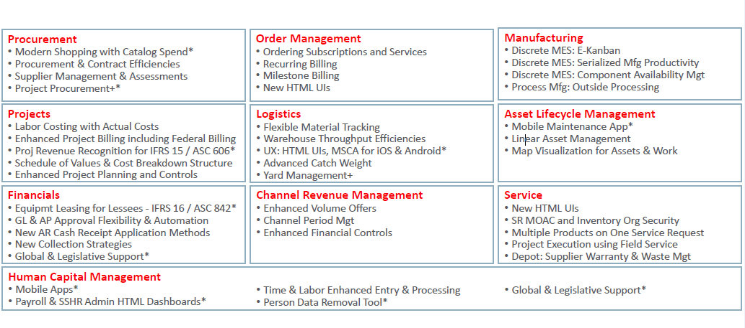
EBS 12.2 Key Enhancement By Product Family

Slide 13
EBS Roadmap and Value Of EBS 12.2.7 Upgrade

Slide 14
EBS Roadmap

Slide 15
EBS Investment & Roadmap

Slide 16
EBS New UI & Mobile Apps

Slide 17
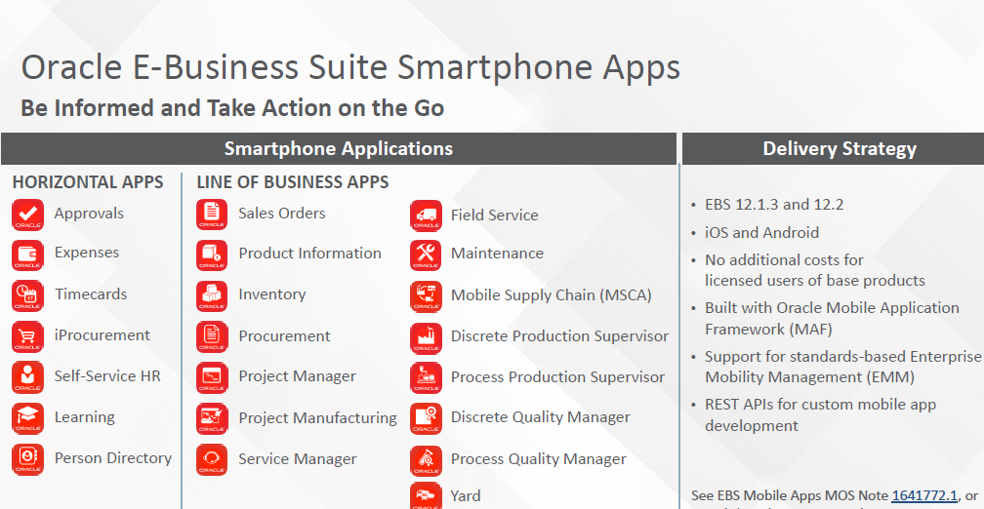
EBS Mobile Apps

Slide 18
EBS On Cloud

Slide 19
EBS On Cloud

Slide 20
EBS 12.2 Upgrade Approach
1
EBS Lift & Shift to Cloud
2
Upgrade Patching
6
Prod Cutover Strategies & Support Transition
3
4
Functional Setup Changes & Migration – Config Snapshot
Customization Remediation and its Migration- DB Impact
5
Testing, Reconciling & Training

Slide 21
Fusion Application and Its Advances

Slide 22
Oracle Fusion Application – Built On Best
EBS → Financial Management
People Soft → Human Capital Management
JD Edwards → Order Management
Siebel → Customer Relationship Management

Slide 23
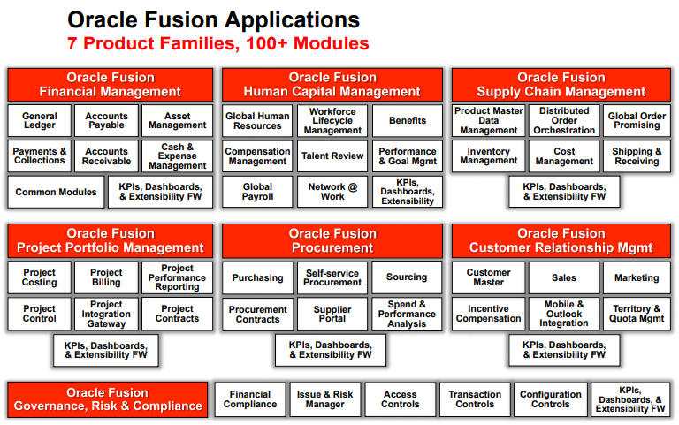
Fusion Application – Pillars & Offerings

Slide 24
Technology & Changes
Technology | EBS | Fusion Cloud
Servers | Oracle Apps Server | Oracle Weblogic
GUI | Forms, JSP, OAF | Oracle ADF, ADF Java Server Faces
Workflow | PL/SQL | BPEL(Business Process Execution Language)
Reports | RDF/XML Publisher | BI Publisher
Analysis | Discoverer | OTBI(Oracle Transactional Business Intelligence)
Access | Responsibilities | Roles
Approvals | AME/Workflow | BPEL/BPM(Business Process Management)
Data Migration | Conversion | FBDI(File Based Data Import)
Setup/Configuration | Application | FSM(Functional Setup Manager)
Application Development | NA | Visual Builder- To Build Integrations, Extensions, Reports. Support Mobile & Voice UI

Slide 25
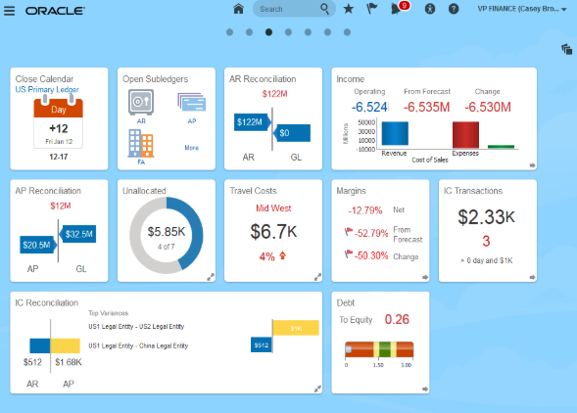
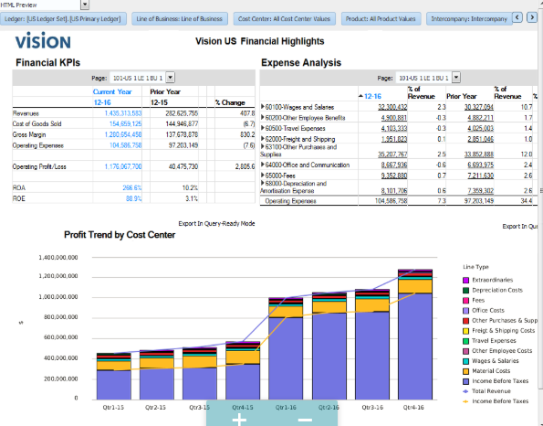
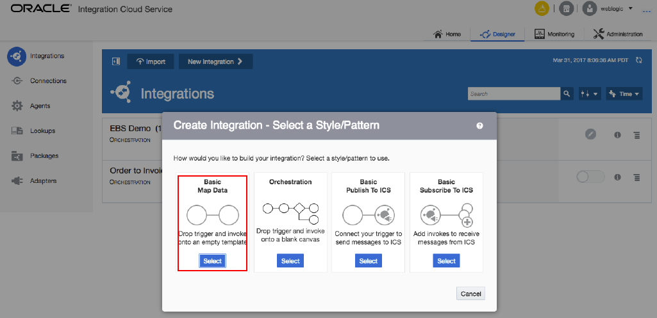
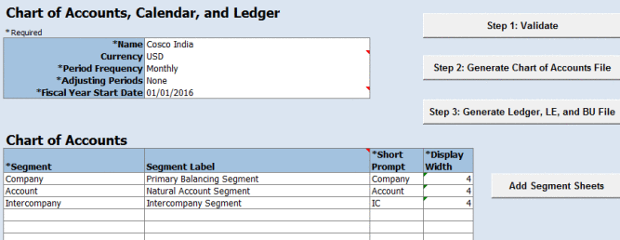
What's There in Fusion Cloud
New UI - Infolets / Dashboard New Reporting Tools
New Integrations New Configuration Tool

Slide 26
Fusion Application – Technology Advances
What’s New | Benefits
Web based intuitive screen design | Reduce training efforts
Task driven workbench and Infolets | Improve productivity
Personalization capability | Improve agility
Mobile Apps for Transaction and Partners | Improve employee mobility and productivity/ Digitally connected to external parties
Transactional BI | Ad-hoc reports capability
Financial Report | Selectable point of views with drill-down capability
Excel Smart View | Slice and dice data for business analytics
Formatted Report | Formatted report with graphical presentation
Transactional dashboard | Provide key metrics
Accessible by managers &department users | Encourage direct accountability
Comprehensive FBDI templates | Improve and automate data entry tasks, reduce IT built costs
New Data APIs | Enable real-time data integration especially for client apps
New SOAP web services | Enable system integration with external applications
Configuration templates | Timesaver configuration tools
Comprehensive documentation | A centralized documentation repository improves accessibility to essential documents
Downloadable templates | Instant download for templates from web site or within applications
BPM Workflow (AMX) | Re-configurable Seeded workflow, Flexible rules to allow business simplification

Slide 27
Fusion Application – Functional Advances
Function | Fusion Cloud
Architecture | Business Structure, Job Roles &Data Roles, Reference Data Set, Project Management, Rapid Implementations
Order Management | Order Orchestration Process, Order Fulfillment, Improved Global Order Promising, Improved Order & Shipping Automation
Pricing | Configurable Business Rules in Pricing policy, Discount rules
Iprocurement | Modern User Experience, Mobile access to punch-out catalogs
Purchasing | Shared Services for REQ, PO, Inv, Enhanced electronic change management, Onetime delivery address
Supplier Portal | Digitally connected to supplier for all TRX, Eliminate off-system communication
Supply Planning | Supply Chain Orchestration
Warehouse Management | Warehouse management enterprise edition
GL | ESSbase Cube, Balancing segments, Centralized Intercompany rules, Financial reporting, Multiple COA hierarchies.
Receivables/Payables | Embedded Analytics, Spread Sheet integrations, Better user interface
HCM | Single integrated solution from ‘Hire to Retire’

Slide 28
The Transition to Fusion Cloud

Slide 29
Fusion Implementation Approach
Design & Scope
Functional design
Configure Fusion
Setup Configuration
Support & Future Rollout
Implement new modules
Validate
Transition to PROD
Validate Solutions with User
Migrate Configurations
GAP analysis
Define Scope
Define migrations
Define Extensions
Define Project Plan
Migrate Data
Built Integrations
Develop Extension
Develop Reports
Load & Reconcile Data
Conduct training
Migrate Extension
Migrate Reports
Migrate & Reconcile Data
Transition to PROD Support
Rollout New Countries
Additional Extension/Reports
Periodic Upgrade & Testing

Slide 30
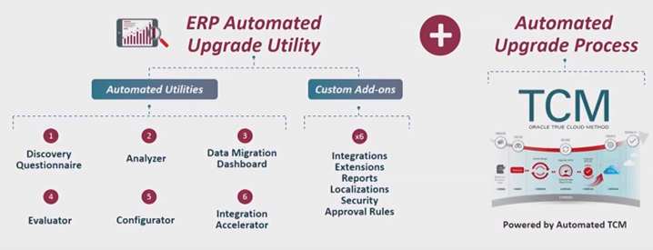
Oracle Soar - Automated Upgrade to Cloud
Evaluator→ Scan EBS for customization
Conf Analyzer→ Extract EBS Configuration parameters(COA, Emp, user etc..)
Auto Configurator → automatically configure setup in Fusion
Auto Data Migration→ Extract data from EBS and loads in fusion
Integrations Accelerator → Library of Fusion Integrations, Connect to apps, SAP etc
Customization Reductions → EBS Customization replaced with standard fusion erp
Customization allowances → Custom Integrations, reports, extension etc…

Slide 31
Technology Adoption – EBS & Fusion Application

Slide 32
EBS 12.2.7 – Adoption Choices

Slide 33
EBS & Fusion Application – Adoption Choices

Slide 34
Practical Paths To Cloud

Slide 35
Practical Coexistence of EBS & Cloud Application

Slide 36
Fusion Application Adoption – Key Drivers
• To exploit specific functional advance to resolve particular business problem SCM Distributed Order Orchestration to centralize Order Processing across multiple Order Capture systems
• To reduce costs or streamline a critical business process
Fusion Financials eliminates costly, manual, & error prone Financial Reconciliation & Disclosure Process with GL
• To rationalize information systems driven by functional change in business
Fusion ERP for Global Financials & Sourcing Processes to eliminate separate instances in each country Oracle Fusion Applications Adoption
• To re-implement information systems driven by a technology change in business Line of Business Executives want to move a particular business process to Software-as-a-Service
• To eliminate a point solution and move more of their processes to Oracle
Fusion Human Capital offers Core HR, Payroll, and Talent Management in single solution On-Premise or SaaS

Slide 37
What Suits Your Business Best- Doyensys Opinion
EBS 12.X Promise: EBS 12.2.X releases promise to provide exiting technology and enhanced functionality. No urgency in moving to Fusion Cloud until Management and users like to adopt modern and cost-effective ERP
EBS Challenges: To Overcome EBS Challenges like Performance issues, Maintenance Cost, Period Close Burdens, In-house support cost can consider to Move to Fusion
Modern & Low Cost ERP: EBS Finance , Procurement, HCM- Cloud Application can offer Modern ERP experience with lower cost
New Feature Adoption: EBS Order management , Projects, Manufacturing should start evaluating the adoption of new functionality and cost benefits of moving to the cloud

Slide 38
What Suits Your Business Best- Doyensys Opinion
Cloud Method: Large Footprint-Phased Approach. Move specific process or specific country
Perception: Moving to Cloud is all about change of business Perception- Losing Control over DB & Integrations, Standardizing the customization, Change Management adoption.
Technology: Integration/Reporting/Extension are Better tools, You Need to know how to use that
Evolving Product: Though Fusion is mature it is still evolving. Leverage the experience from early adopters.
Final Words: How business/Application is ready to go for Fusion Cloud. The migration to the cloud is inevitable, but the timing of this move is flexible.

Slide 39
References
E-Business Suite 12.2.7 Upgrade - A Comprehensive Methodology and Roadmap – OAUG Collaborate-18
Customization Capabilities Of Oracle Fusion Cloud: A Developer Perspective – TLOAUG 18
Functional Advances and Benefits of Fusion Cloud Modules – Quick Reference
Oracle Fusion Cloud Migration: Quick Technical Reference

Slide 40
Questions and Answers vimal.manimozhi@doyensys.com https://www.linkedin.com/in/vimalathithanm

