Slide 1
Redefining Item Master for Easy Maintenance in E-Business Suite
10683
Item Maintenance in EBS
Archana Raghu PMP®
Project Lead
Doyen Systems Pvt Ltd.
April-2019
Notes:
This session is about creating and maintaining item master data in EBS. Based on the industry type, there might be different requirements in how we create and maintain items. There are several departments within the organization involved in providing the inputs for an item. This is a custom framework that can be used for item creation and update in EBS. We will discuss about the features and advantages of this solution as compared to the standard features in EBS.

Slide 2
Who We Are
A TECHNOLOGY SERVICE COMPANY THAT
PROVIDES INNOVATIVE SOLUTIONS AROUND THE ORACLE PLATFORM
With Laser focus on customer delight as the primary success parameter
Located at
Established
2006
Team strength
250+
US . India . Canada
Notes:
Our company was founded in 2006 in both US and India. We have 200+ employees and work primarily on Oracle technologies. We provide Oracle based solutions to our customers using a process driven global delivery model.

Slide 3
What We Do
SERVICE OFFERINGS
Oracle EBS
Packaged Applications
Oracle Fusion
Oracle Database and Middleware administration
Software Services
Software Development
Oracle APEX Development
Lift and Shift
Oracle Custom Development
Notes:
Our company was founded in 2006 in both US and India. We have 200+ employees and work primarily on Oracle technologies. We provide Oracle based solutions to our customers using a process driven global delivery model.

Slide 4
Presenter Info
Archana Raghu
Project Lead, Doyen Systems Pvt Ltd
13+ Years of experience in Oracle technologies like EBS, Fusion Applications, OBIEE, APEX, ADF etc.
Certified Project Management Professional PMP® and Certified Procurement Cloud 2017 Implementation Specialist
Worked on several projects focusing on conceptualizing business needs and translating them into viable technical solutions.
Successful analysis and problem-solving expertise and proven project management experience.

Slide 5
Agenda
Challenges in Item Maintenance
Item Master Data Management - Highlights
Workflow process
Mass Upload & Approval
Reports
Demo
Conclusion
Notes:
Let us begin with the highlights or the important features of this custom solution – The Item Master Data Management as against the features of Oracle EBS. Then we will discuss about the item code and the templates – how they are being handled. Then move on to the workflow process that was built around creation of items. We also have add-on features of uploading mass items and several custom reports that helps us in generating item data. We will see a short demo on how this solution works. With that we will conclude after Q & A.

Slide 6
Introduction to Item Management

Slide 7
Challenges in Item Maintenance
Duplicate items created
Wrong categories/ attributes mapped
Issues realized at a later point of time – during transactions
No workflow available for item creation
No processes around item creation

Slide 8
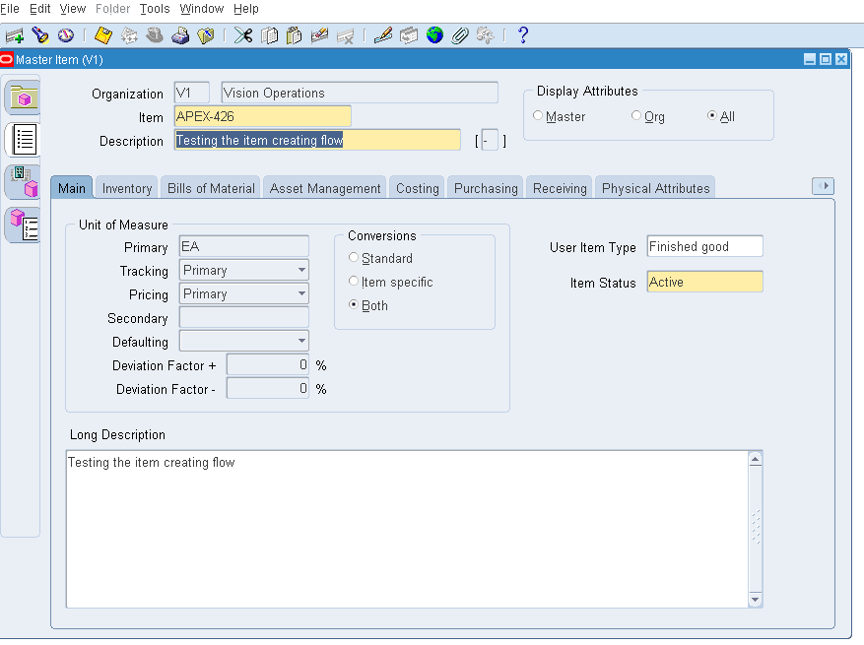
Items in EBS

Slide 9
Highlights
Generate unique item code
Configurable approval workflow
Data security based on user roles
Item Synchronization between IMDM and Oracle EBS
Allows item creation and update both at Master level and Organization level
Allows transfer of multiple items to EBS simultaneously
Notes:
Custom solution to manage Item Master data in Oracle EBS.

Slide 10
Highlights
Option to handle drawing and spec sheet attachments
Reports to view the list of items along with their statuses at any time during the workflow.
Error reports that provide details of the interface errors.
Mass Upload option – To upload bulk item data to EBS.
Mass Approval option – To Upload Approved bulk item data to EBS.
Features to handle DFF values.

Slide 11
Item Code & Item Template

Slide 12
Item Code Creation
Item Creation process
Automatic
Manual
Details to be entered
Item Description
Long Description
Primary UOM
Template Name
Notes:
Unique item code is generated when automatic option is chosen

Slide 13
Switch Org
Admin option allows change of inventory org or function.
Data security handled for the users based on the access required.
Attributes can be updated at the organization level.
Notes:
Admin options – switch departments & switch organizations.

Slide 14
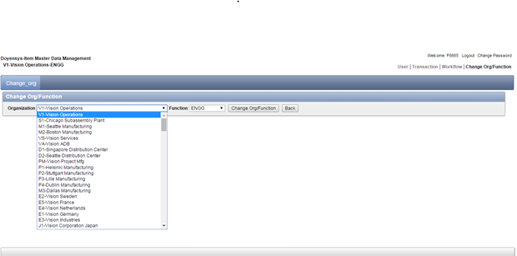
Switch Org

Slide 15
Template Form
Transactions Tab → Templates Form
ATO Item
ATO Model
Finished Good
Purchased Item
One time Setup of flag to define the workflow process for each of the templates

Slide 16
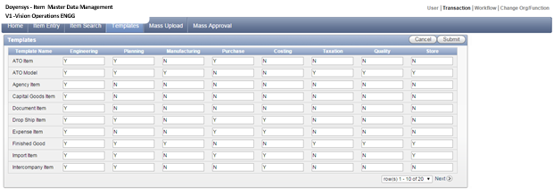
Template Form
Grid for each template with the defined departments
Flag set for the departments involved in each template.
Framework to trigger approval workflow

Slide 17
Approval Workflow

Slide 18
Workflow Process
Engineering
Planning
Manufacturing
Purchase
Costing
Taxation
Quality
Store
Notes:
Configurable and customizable workflow framework

Slide 19
Workflow Process
Process initiated by Engineering department
View the Pending Items Report
Enter the engineering attributes for the item and submit.
Workflow moves to the next department based on the the setup
Complete the flow to get attributes entered by all departments

Slide 20
Workflow Process
Again moved to Engineering department for review
Items reviewed and moved to Apps
Items Update option also available

Slide 21
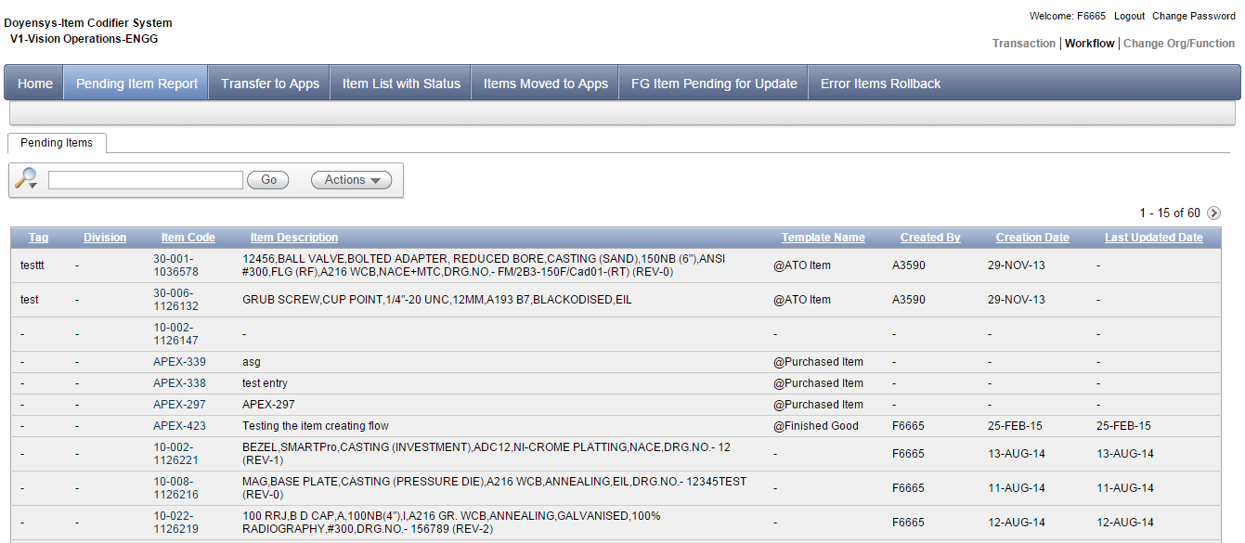
Workflow Process
Items pending to be moved to EBS listed – Pending Items Report
Click on the item code and enter the attributes
Notes:
Unique item codes that are already created in the application are available in this report. Engineering department can choose one of them in the drill down report and them move on to enter the attributes. Items here are processed one at a time as they have to go through the workflow.

Slide 22
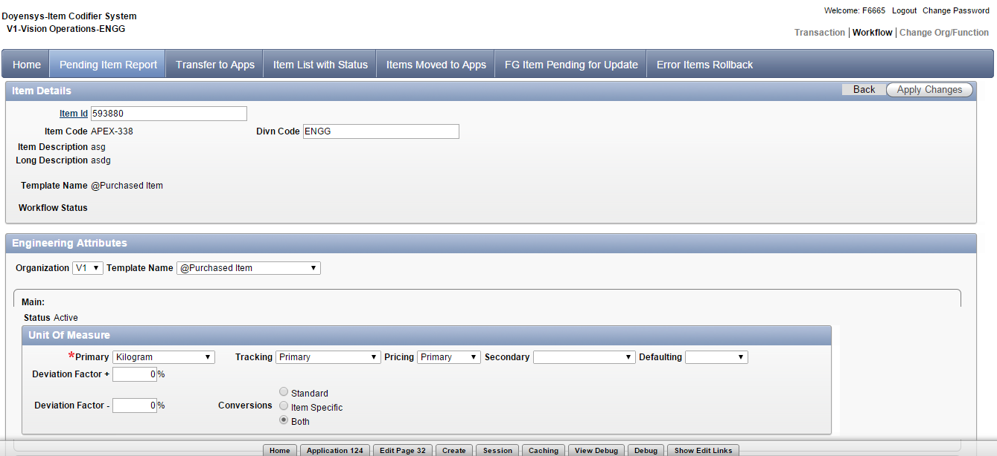
Workflow Process
Enter Engineering attributes and Click on ‘Apply’.

Slide 23
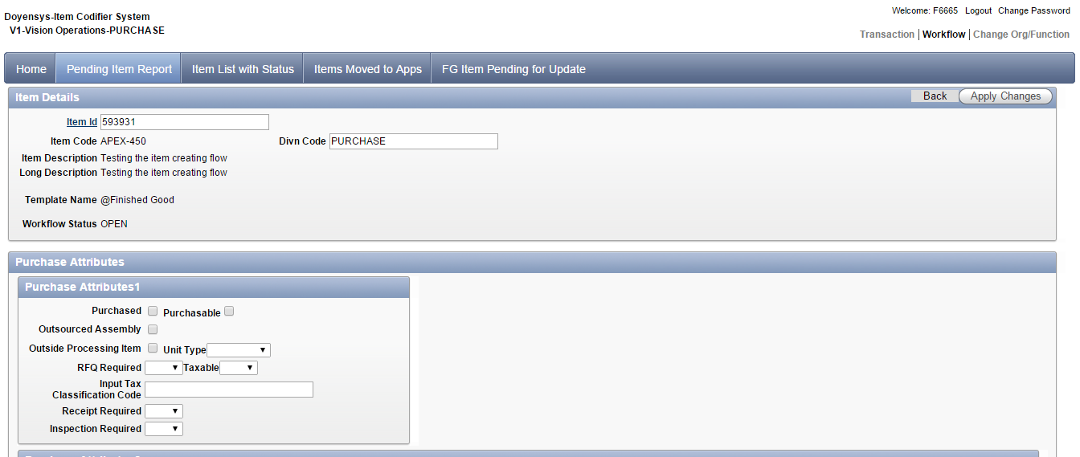
Workflow Process
Workflow then moves to the next department.
List of Purchasing attributes are displayed.
Enter the attributes and click on Apply to move the workflow further.

Slide 24
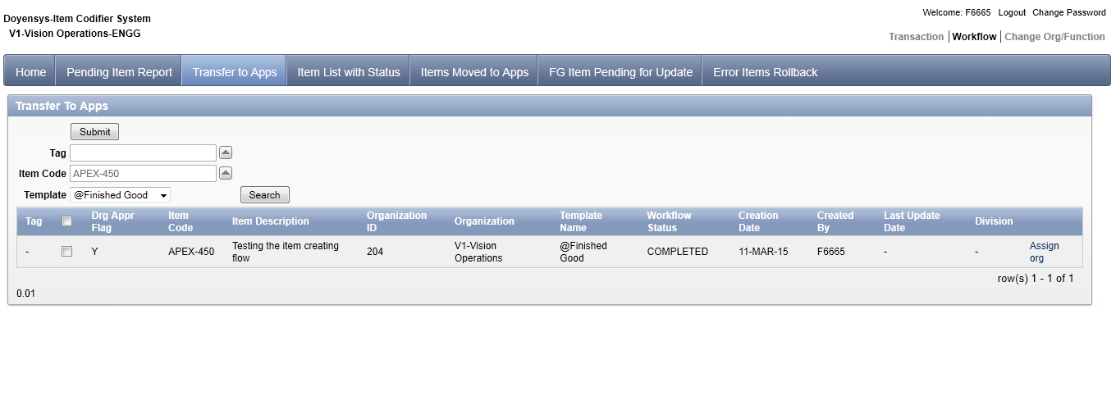
Workflow Process
Item code generated for Master org and Inventory Org
Engineering department view Transfer to Apps screen to transfer the items to EBS.
Notes:
Once all the departments have entered the attributes ,the item code will be created for the organization selected and also for the master organization.

Slide 25
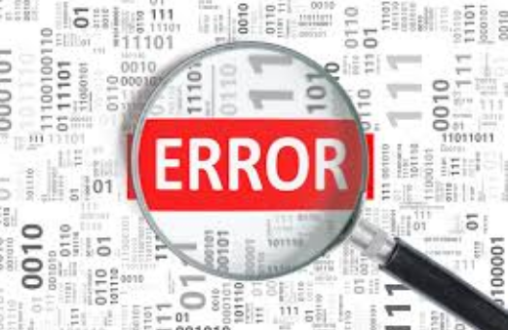
Error Handling
Select the item to be moved to EBS using the Checkbox
Click on Submit.
Errors displayed in the below region

Slide 26
Mass Upload & Approval

Slide 27
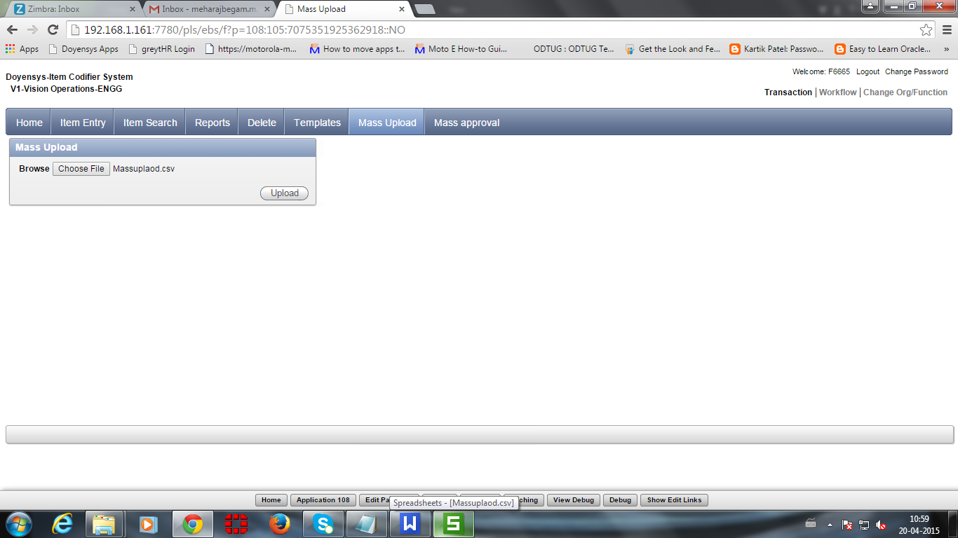
Mass Upload
Process to upload bulk data for approval process.
Transaction Tab → Mass Upload
Browse the File → Click on Upload

Slide 28
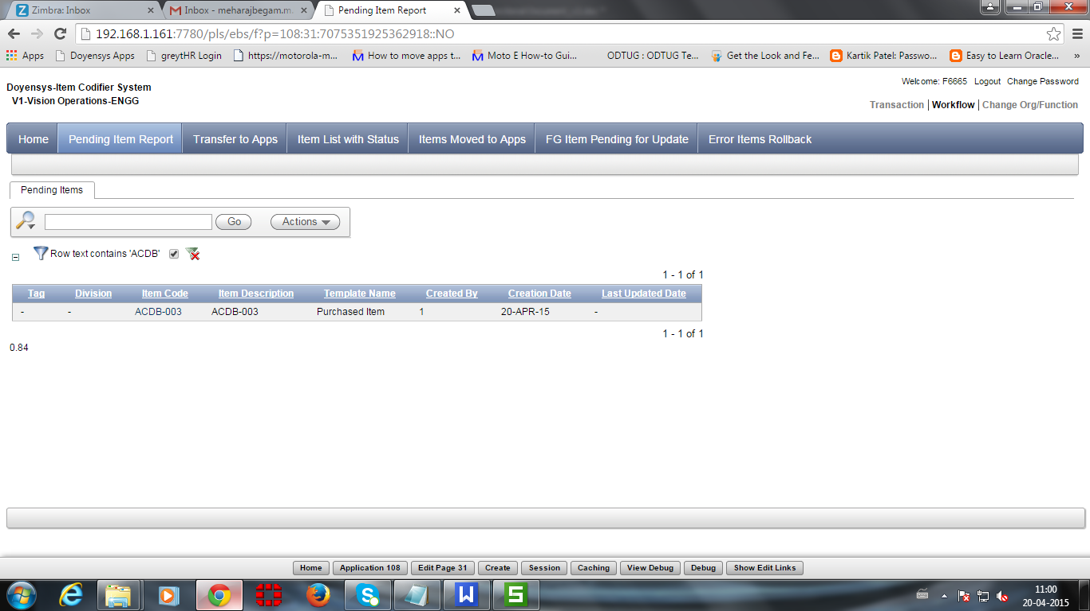
Mass Upload
Uploaded Item will be displayed in Pending Item Report

Slide 29
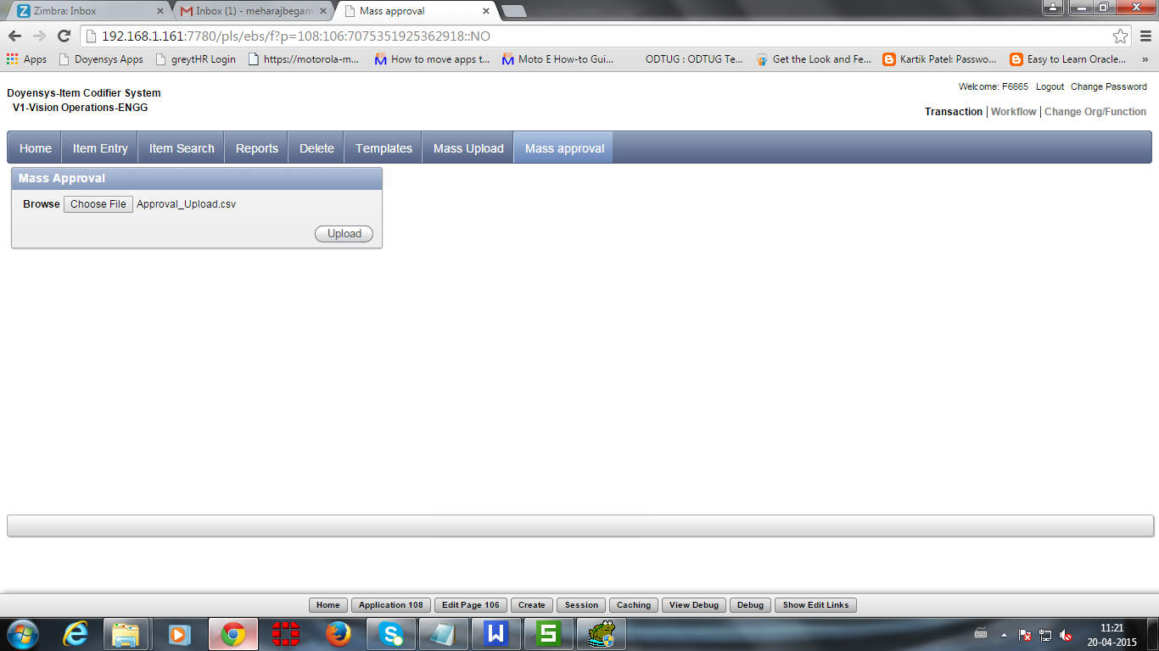
Mass Approval
Process to upload approved bulk data
Transaction Tab → Mass Approval
Browse the File → Click on Upload

Slide 30
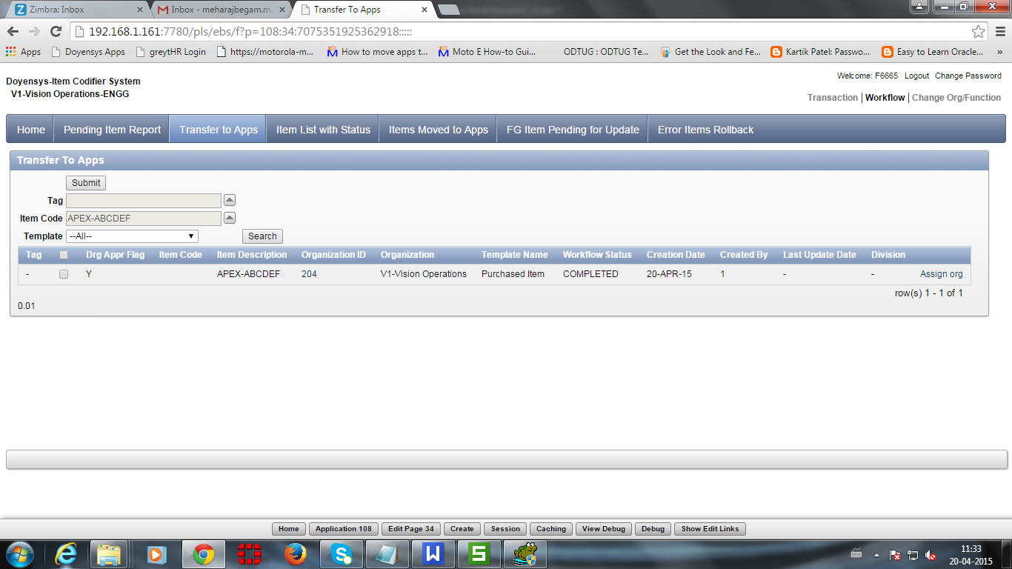
Mass Approval
Uploaded data is now available in Transfer to Apps page

Slide 31
Reports

Slide 32
Reports
Pending Items Report
Transfer to Apps Report
Items Moved to Apps
Item List with Status

Slide 33
Pending Items Report
Items Pending to be transferred to EBS
before the workflow process
Notes:
The Pending Items Report displays the items created from the IMDM transaction system that are pending to be transferred to Oracle Applications. The attributes for the items are to be updated before it is transferred to Oracle Apps. The workflow starts with the Engineering attribute followed by Sales category, Planning attributes, Store attributes, Purchase attributes, QA attributes, Costing attributes, Tax attributes and Manufacturing attributes. Once all the attributes are updated, and Status =’CLOSED’the items are moved to the Transfer to Apps tab.In Engineering Department,DFF values are able to update

Slide 34
Transfer to Apps
Items ready to be transferred to EBS.
After completion of approval process.
Assigning the child org to the Master
Notes:
Mass Approval data loaded to this report and can be moved to EBS from this report
All the items from the Pending Items Report are available in the Transfer to Apps report ready to be transferred to Oracle Apps if all the mandatory attributes are updated.Child Org also able to assign in Transfer to Apps tab.
Different attributes for Master and Child Org during Item Creation
Before moving the items to Apps, below are the possibilities of defining different Attributes
(i) Only the Org level attributes can be updated in both Master and Child Org For example Check ATP, ATP
Components, DFF Values
(ii) If the Master level attributes are changed, then it will not be updated in Child Org
(iii) If the Child level attributes are changed, then it will be updated in Child Org only

Slide 35
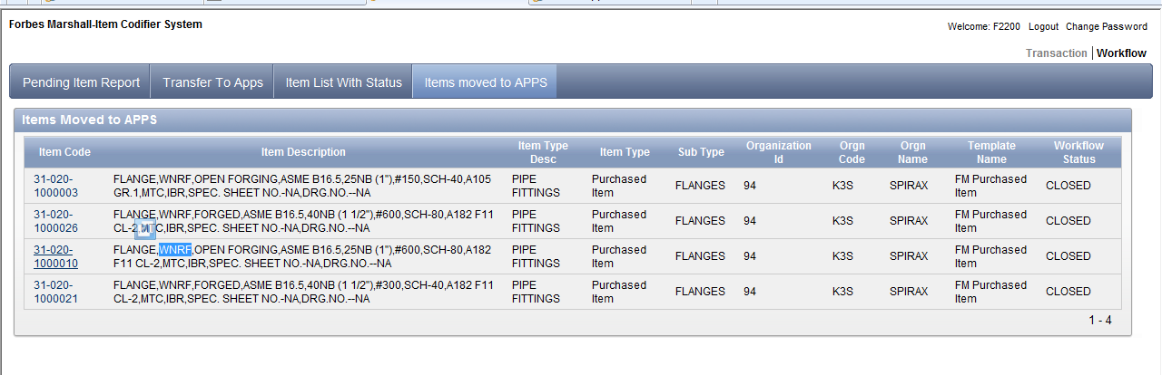
Items Moved to Apps
Newly created items are displayed.
Synchronization of data between EBS and IMDM application

Slide 36
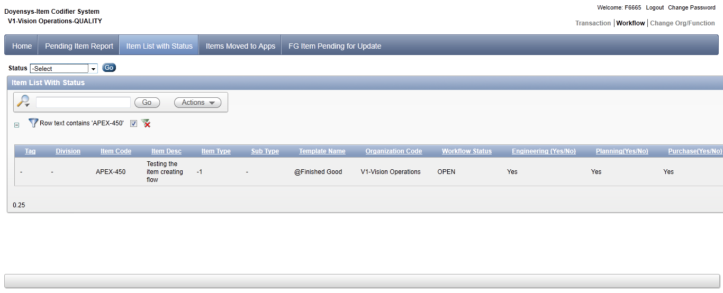
Items List with Status
Provides the status of items in workflow
Items ‘In-Process’

Slide 37
Demo

Slide 38
Conclusion

Slide 39
Conclusion
Avoid item duplication – reduced number of items
Easy maintenance of item data with a defined process
Seamlessly create and maintain item data with inputs from different departments
Drill down reports for any time information.
Secured role based data handling

Slide 40
Q & A
archana.raghu@Doyensys.com
10683

