Slide 1
Transform to Smart ERP Using Custom Mobile Apps
10008
Archana Raghu PMP®
Project Lead
Doyen Systems Pvt Ltd.
EBS Mobile App
April-2018

Slide 2
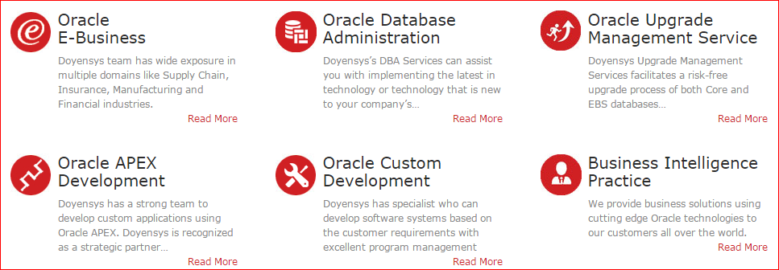
Our People (Based out of USA & India)
240+ people with expertise in Oracle E-Business Suite and Core Oracle Technology
Qualifications
91% - Certified Professionals
PMI - PMP
MBA / Engineers
Serving Customers for last 10+ years

Slide 3
Presenter Info
Archana Raghu
Project Lead, Doyen Systems Pvt Ltd
12+ Years of experience in Oracle technologies like EBS, PL/SQL, OBIEE, APEX etc.
Certified Project Management Professional PMP® and worked on several projects focusing on conceptualizing business needs and translating them into viable technical solutions.
Successful analysis and problem-solving expertise and proven project management experience.

Slide 4
What is REST
How to develop EBS Mobile Apps
Deploy REST Services
Demo
Create Mobile Application
Demo

Slide 5
What is REST?

Slide 6
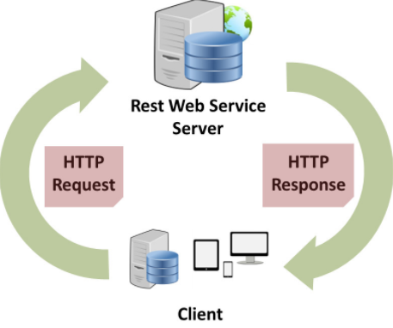
RESTful Web Services
REST is Representational State Transfer
Architectural style.
Provides interoperability between systems
Data transmitted over HTTP Protocol
Applied on Web Service to induce performance, scalability, modifiability
Data and Functionality are the resources
Uniquely identified by Uniform Resource Identifiers
Notes:
REST is Representational State Transfer. It is an architectural style that provides connectivity between two systems irrespective of the framework used.
It uses the HTTP Protocol.

Slide 7
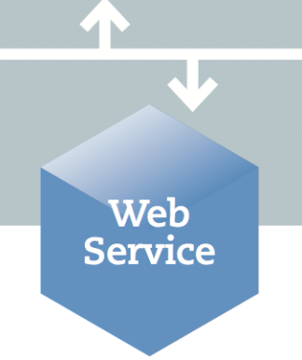
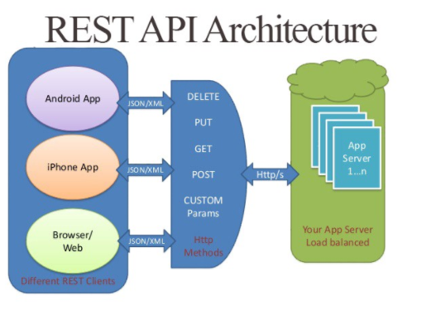
RESTful Web Services
RESTful applications to be simple, lightweight, and fast
REST Server provides access to resources.
EBS uses PLSQL API for POST operation, and JAVA API for GET/ POST operations.
Collection of open protocols and standards for exchanging data
Notes:
A Web Service that uses REST is called REST or RESTful Web Services.

Slide 8
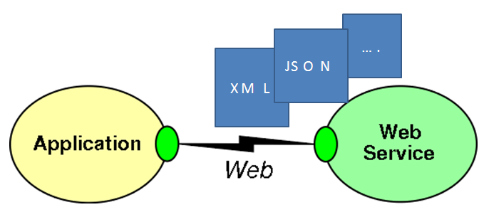
RESTful Web Services
Applications and their features exchange data and information through defined APIs
Expose business functionality irrespective of the platform or language of the originating application
In a mobile application, web services are used to interact with remote data sources
To query data in remote data sources.
To write data to and from remote data sources.
Notes:
Applications and their features exchange data and information through defined APIs. These APIs can be the seeded ones provided by Oracle EBS or deploy custom APIs to EBS to expose EBS objects, concurrent programs etc.

Slide 9
RESTful Web Services
Resources are manipulated using a fixed set of create, read, update, delete operations
PUT, GET, POST, and DELETE
PUT creates a new resource (CREATE)
DELETE deletes a resource (DELETE)
GET retrieves the current state of the resource (QUERY)
POST transfers a new state onto a resource (UPDATE)
PATCH (PARTIAL UPDATE)
content can be accessed in a variety of formats, such as HTML, XML, plain text, PDF, JPEG, JSON, and others
A RESTful API is an application program interface (API) that uses HTTP requests to GET, PUT, POST and DELETE data
breaks down a transaction to create a series of small modules.
Each module addresses a particular underlying part of the transaction
Notes:
We can perform Create, Read, Update and Delete operations on the resources through REST Services. For these operations, we use various HTTP Methods

Slide 10
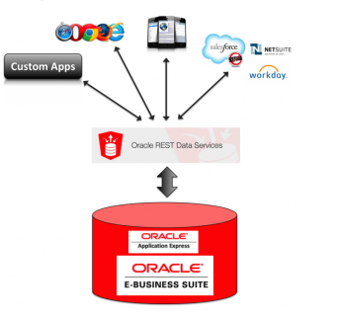
RESTful Web Services
provide a common data access layer that can be accessed from any platform
can be called from your Web Browser
Widely Used: Twitter, Netflix, Dropbox, PayPal, Flickr, Amazon S3
Stateless: being stateless reduces overhead and complexity on the server
Scalable: supports caching, light weight
Notes:
provide a common data access layer that can be accessed from any platform
can be called from your Web Browser

Slide 11
How to develop EBS Mobile Apps

Slide 12
How to develop Mobile App
REST Service
EBS Seeded REST API
EBS Custom REST API
APEX REST Service
Custom App Tool
Mobile Application Framework
Mobile Suite – Login Component
APEX Mobile App
Output
Android Device
iOS Device
Web browser
Notes:
These are different ways in which a custom mobile app can be developed and deployed for EBS.

Slide 13
Introduction to EBS Mobile Apps
Mobile apps exchange data with Oracle EBS through REST services
provided through Oracle E-Business Suite Integrated SOA Gateway (ISG)
ISG is the gateway of Oracle E-Business Suite for service enablement
Oracle seeded APIs are available to be used from Integration Repository.
Custom Interfaces can also be used if the functionality cannot be achieved using Seeded API
Notes:
ISG – gateway for deploying REST Services.
Oracle seeded APIs and custom APIs can be developed and deployed

Slide 14
Integrated SOA Gateway
Oracle Integrated SOA (Service Oriented Architecture) is a complete set of service infrastructure to provide and administer Oracle EBS Web Services.
centralized repository that contains numerous interface endpoints within EBS
ISG provides the functionality to expose these integration interfaces published in the Integration Repository as SOAP and REST based web services.
It supports PLSQL API’s , JAVA API’s, Concurrent Programs, XML Gateway, Business Events etc. to be exposed as Web Services.
Notes:
Oracle E-Business Suite Integrated SOA Gateway (ISG) provides a SOA based infrastructure to provide, consume and monitor web services from E-Business Suite
It is a complete repository of all the integrations for EBS.
Use the Integration Repository user interface to perform design-time activities such as generate and deploy Oracle E-Business Suite Web services

Slide 15
Deploy REST Services

Slide 16
Configuring REST Services
Enable ASADMIN user with the Integration Administrator role (or the Integration Repository Administrator role)
Create a folder called <ISG_TEMP> in Oracle E-Business Suite. This folder should have write permission.
In the $INST_TOP/soa/ folder, update ISG_TEMP_DIRECTORY_LOCATION property in the isgagent.properties
Run the txkISGConfigurator.xml utility with “ebsSetup” argument. The script will stop and restart the servers
Notes:
This slide talks about the standard configurations required for deploying REST Services in ISG.

Slide 17
Implementing EBS REST Services
manage REST service lifecycle activities
search and deploy desired APIs as REST services
view deployed services through WADL descriptions
grant user access privileges for the services
Testing and Validating the REST Services
Notes:
steps required to search and deploy REST Services in ISG.

Slide 18
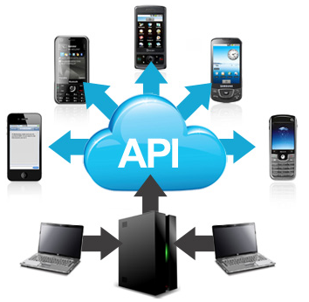
Implementing Oracle Seeded Mobile APIs
Oracle provides APIs in Integration Repository
Search, view, and deploy API as REST service
Mobile apps can be developed based on any mobile development framework.
The APIs published in one app can be used in another custom app irrespective of the framework used.
Apply REST API Patches for Custom App Development in your Oracle E-Business Suite instance
Notes:
Mobile apps can be developed based on any mobile development framework. REST APIs once deployed in ISG can be used across mobile apps. But we need to apply REST API patches for custom mobile development in EBS.

Slide 19
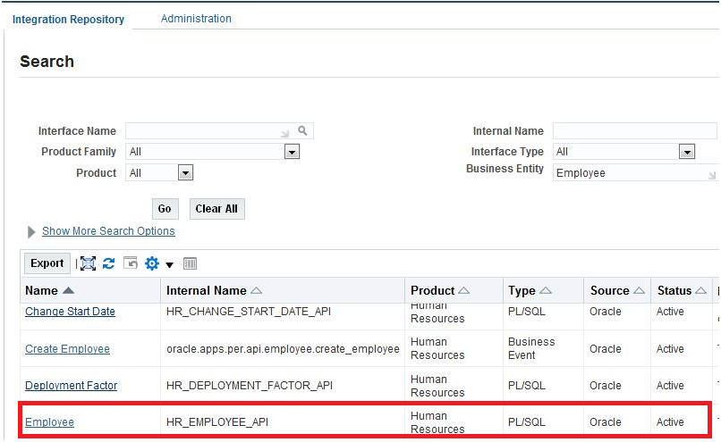
Validating REST Services
Integrated SOA Gateway responsibility → Integration Repository link → Search

Slide 20
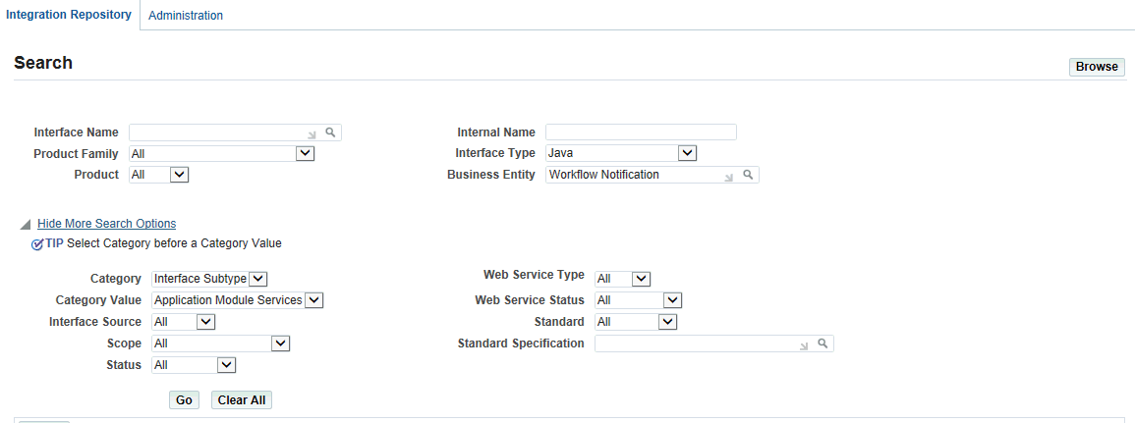
Search Options
Each API is associated with a business entity
Display all Oracle E-Business Suite integration interface definitions through Oracle Integration Repository
Support custom integration interfaces from Oracle Integration Repository
Role-based access control security to allow only authorized users
Search for Oracle E-Business Suite public interface or API based on product, business entity, or interface type

Slide 21
Security Grants
Create security grants for an interface.
Ensure that only users with authorized privileges can access certain methods of an interface.
mobile app access roles check if a user has the privilege to access the associated mobile apps
then loads relevant responsibilities for that user
Notes:
Security grants are very important to limit the access based on the users. For every interface/ REST API deployed, security grant must be provided.

Slide 22
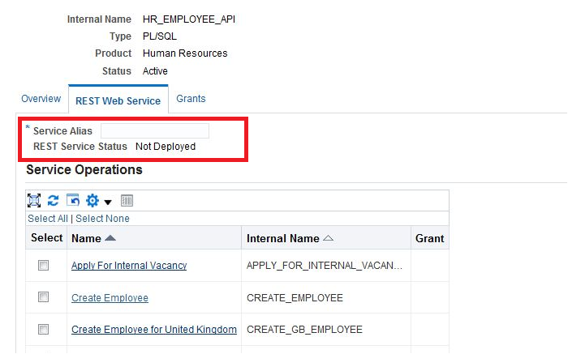
Deploy an Interface
Click Deploy button in the REST Web Service tab
Notes:
Click on the check box of the required REST API and click on Deploy button. The status will now be changed to Deployed.

Slide 23
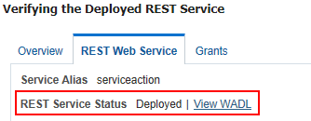
View WADL
"Deployed" should appear as the REST Service Status value
Service is available for use on the Oracle E-Business Suite server
View the deployed WADL description by clicking the View WADL link in the REST Web Service tab.
WADL URLs form:
http://<hostname>:<port>/webservices/rest/<service_alias>?WADL
Notes:
Click on the link. It shows the physical location of the service endpoint where the service is hosted.

Slide 24
Demo – Deploy PL/SQL API as REST Service

Slide 25
Create Mobile Application

Slide 26
RESTful Web Services
Employ web services in MAF applications
To add functionality that is readily available as a web service, but which would be time-consuming to develop within the application.
To provide access to an application that runs on a different architecture.
jDeveloper lets you create a data control for an existing REST web service
This REST web service returns an XML response.
Associate a REST web service data control with one or more HTTP methods using the same connection
Access custom operations exposed by a REST service
Custom operations map to one of the HTTP methods
Allows to create a data control to expose these custom operations on the client.
Notes:
jDeveloper lets you create a data control for an existing REST web service
This REST web service returns an XML response.
You can associate a REST web service data control with one or more HTTP methods using the same connection

Slide 27
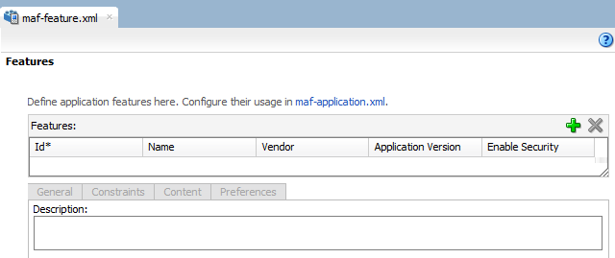
Create a MAF Application
Open jDeveloper
File → Application → New → Mobile Application Framework Application
Click on OK
Two projects (ApplicationController and ViewController)
Two data controls (ApplicationFeatures and DeviceFeatures).
ViewController → Opens maf-features.xml file
Add application features

Slide 28
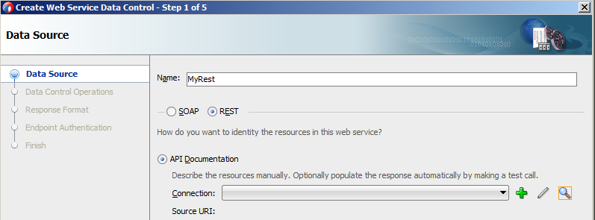
Create a REST Data Control
File > New > From Gallery > Web Services
Select Web Service Data Control (SOAP/REST)
Click on OK
Data Source page > Create Web Service Data Control wizard > select REST

Slide 29
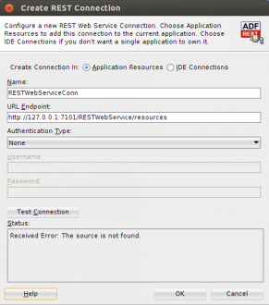
Create a REST Data Control
Create REST Connection by providing a name and the URL from EBS REST Service Deployed previously

Slide 30
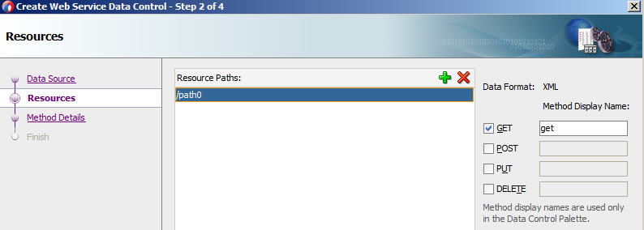
Create a REST Data Control
MAF Supports all HTTP method types – GET, POST, PUT, DELETE
You can include all four methods using the same connection and the same REST web service data control.

Slide 31
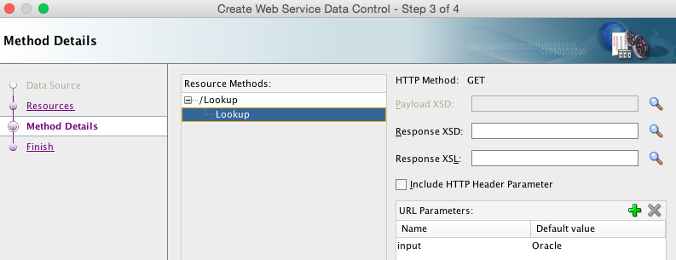
Create a REST Data Control
specify the parameter to be used when sending the service request.
In the Resource Methods property, select the branch node (second instance) of Lookup
Click the green plus sign by the URI Parameters property and set the following properties.

Slide 32
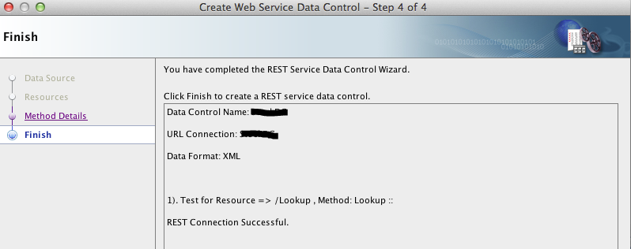
Create a REST Data Control
Test the REST connection to make sure it is reachable by clicking Test REST Connection ,button in the lower right of the pane.
When the test is successful, click Finish.

Slide 33
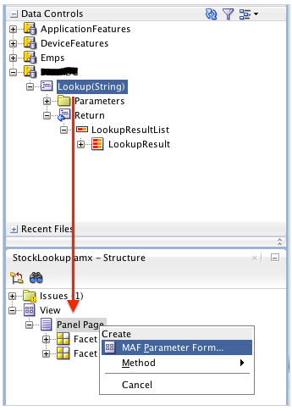
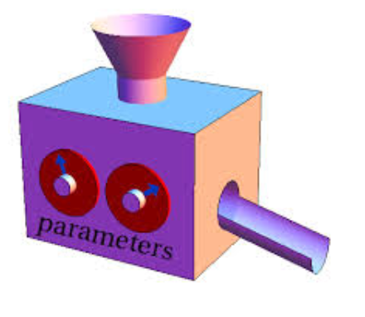
Add Parameters to the Page
In the data control window, drag the Lookup(String) operation onto the Structure window and drop it on the Panel Page as a MAF Parameter Form.
In the popup menu, select MAF Parameter Form…

Slide 34
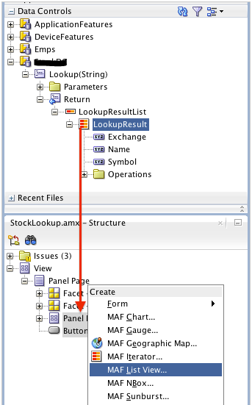
Add Return Attribute to Page
In the Data Controls window, expand the Lookup(String) > Return > LookupResultList node.
Select the LookupResult collection, drag it onto the Structure window and drop it on the Panel Page as a MAF List View.

Slide 35
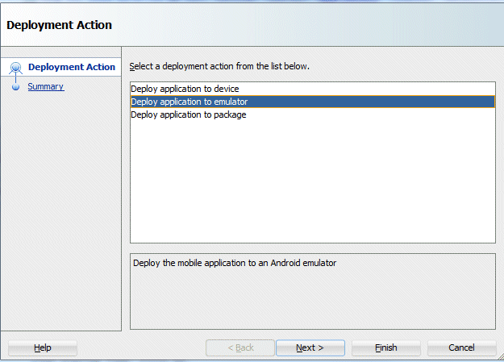
Deployment
In the deploy dialog, select Deploy application to Simulator (iOS) or Deploy application to Emulator (Android)
Press Finish to deploy.

Slide 36
Demo – Consume REST Service in MAF

Slide 37
Conclusion
Oracle has provided a lot of Seeded apps for Approvals, Inventory etc.
These can be customized to include organization specific requirements.
Choose the appropriate method of developing the mobile apps.
Custom mobile apps can also be built to have
reports/ dashboards for top management
Daily reports/ data for collection agents/ salespersons
New functionalities/ custom modules/ custom pages

Slide 38
k.r.archana@gmail.com
10008

